Slide 1
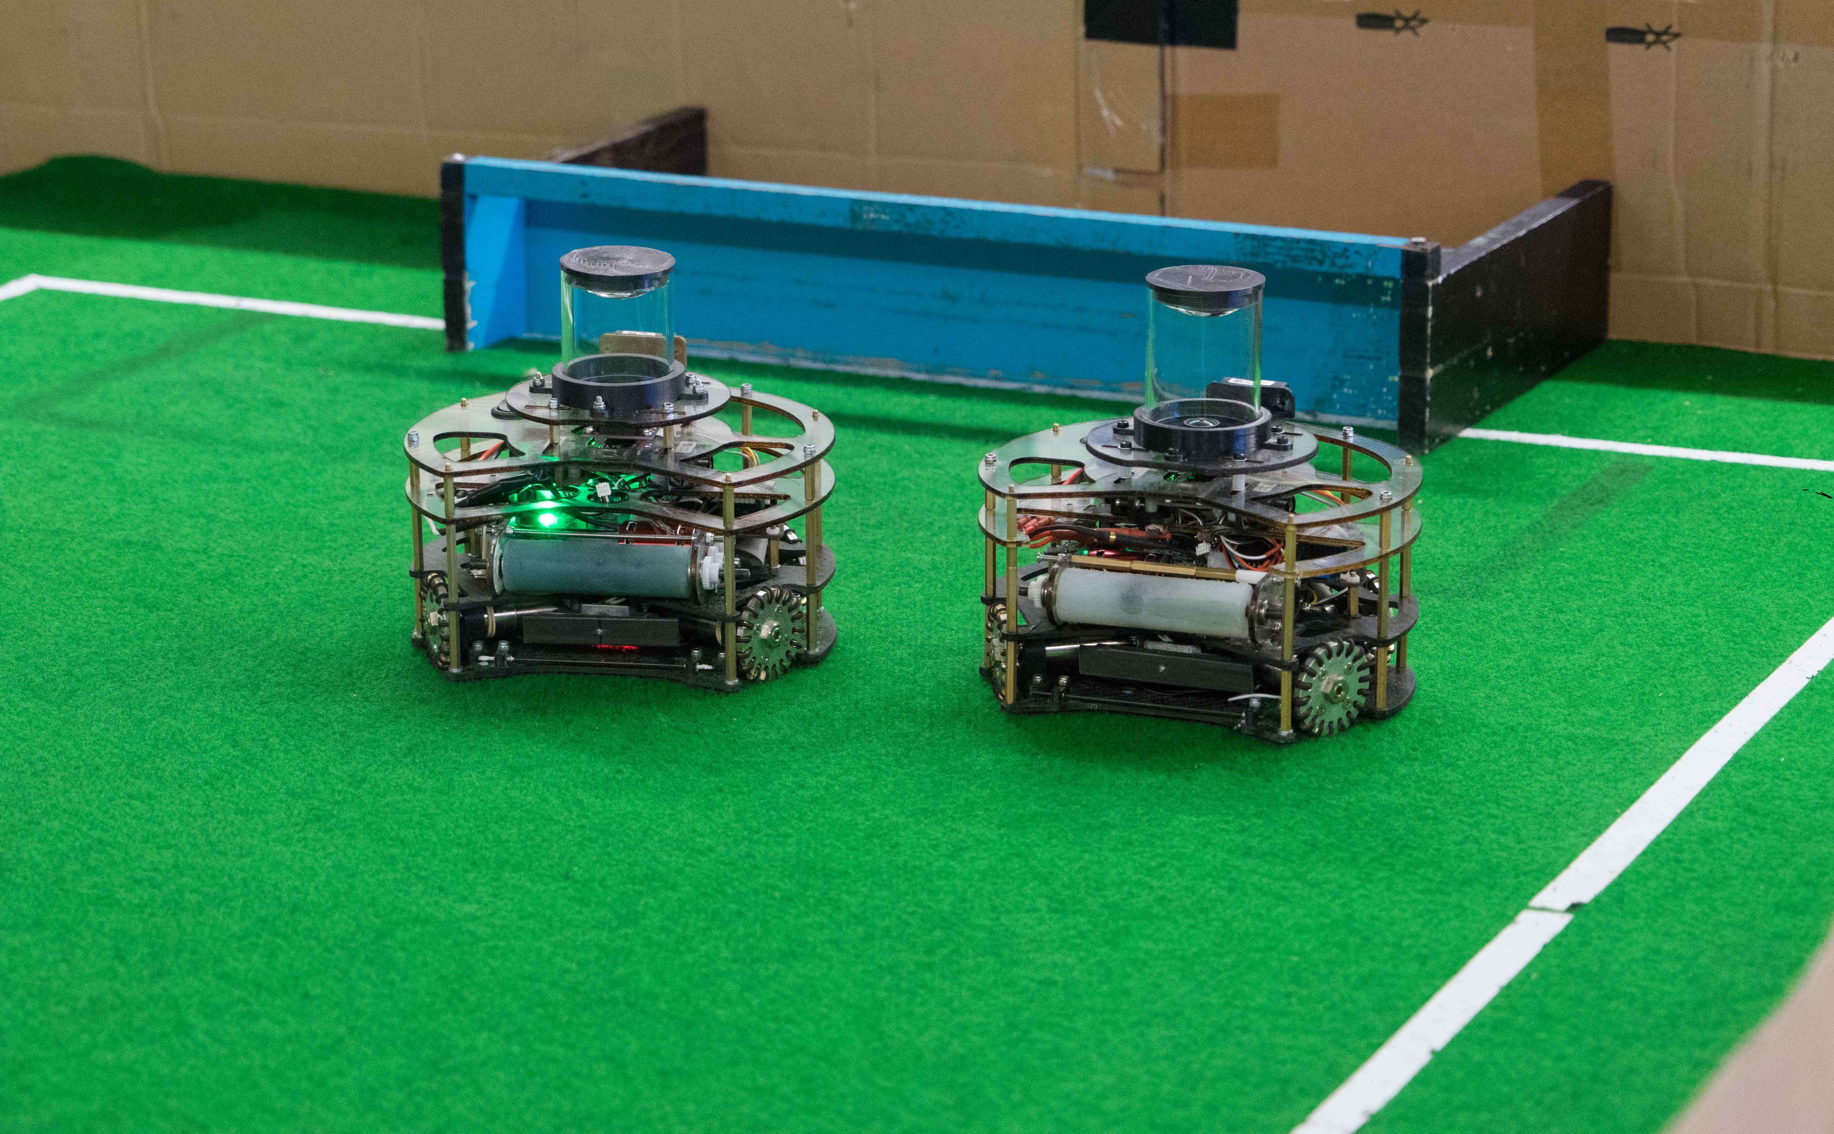
FG&B
BRISBANE BOYS’ COLLEGE - AUSTRALIA
Notes:
Will change background

Slide 2

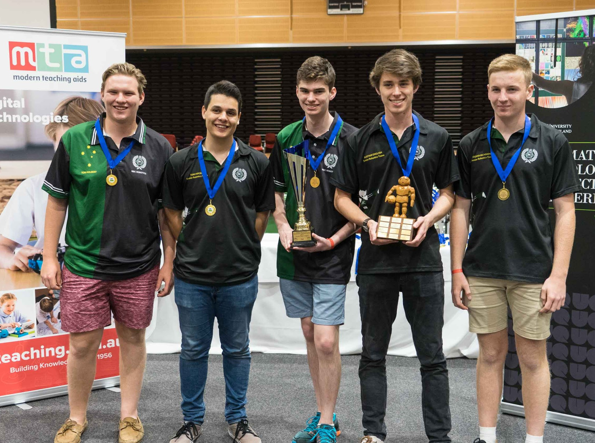
TEAM MEMBERS
G’day mate! Bonjour!
Our team is from the city of Brisbane, Australia’s third largest city
We won the Open Soccer Regional, State and National Championships in Australia in 2017
FG&B members all have many years of experience at Robocup Junior in Australia, having competed in both rescue and soccer.
We joined to form a team in 2015 to compete in open soccer.
During the semester, our team met often during our free time and weekends to work on the robots.
We also used team message chats and group calls to discuss the robots and the progress made on them.
Thomas Hulbert
Primary Electrical Developer
Secondary Hardware Developer
Thomas Hulbert
Primary Electrical Developer
Secondary Hardware Developer
William Plummer
Secondary Hardware Developer
Documentation
Cooper Richmond
Secondary Electrical Developer
Primary Hardware Developer
Thomas Fraser
Primary Robot Software Developer
Alistair English
Primary Robot Strategy Developer
Notes:
will

Slide 3
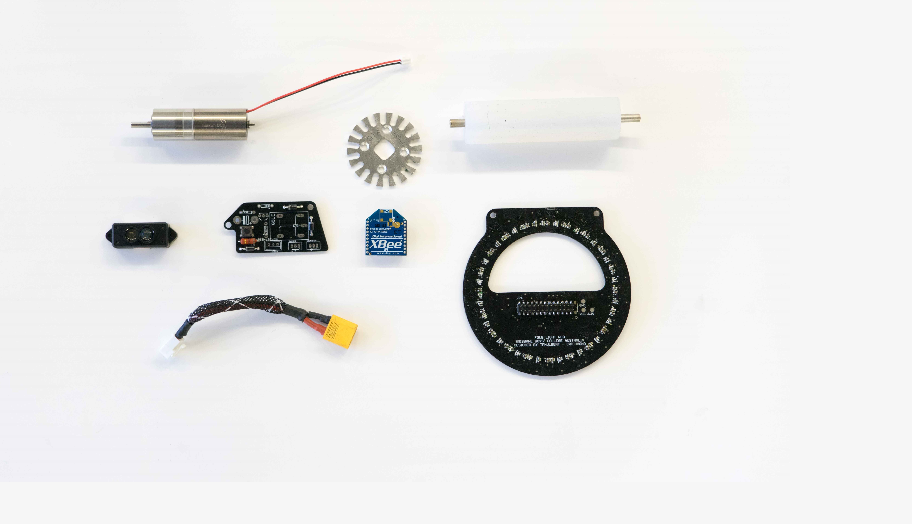
HARDWARE
Notes:
cooper

Slide 4
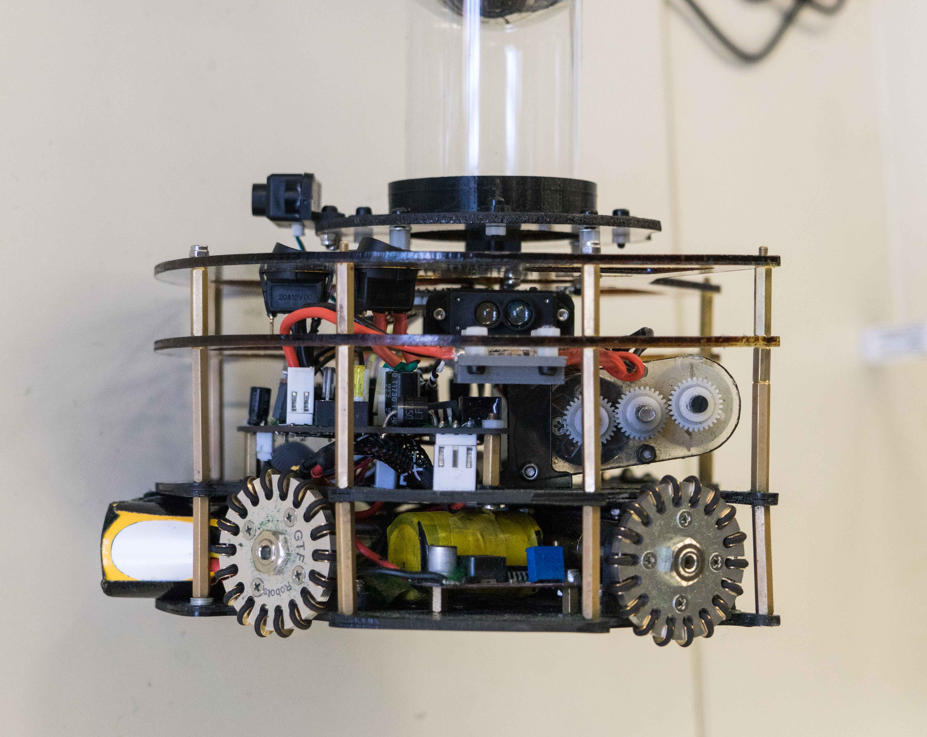
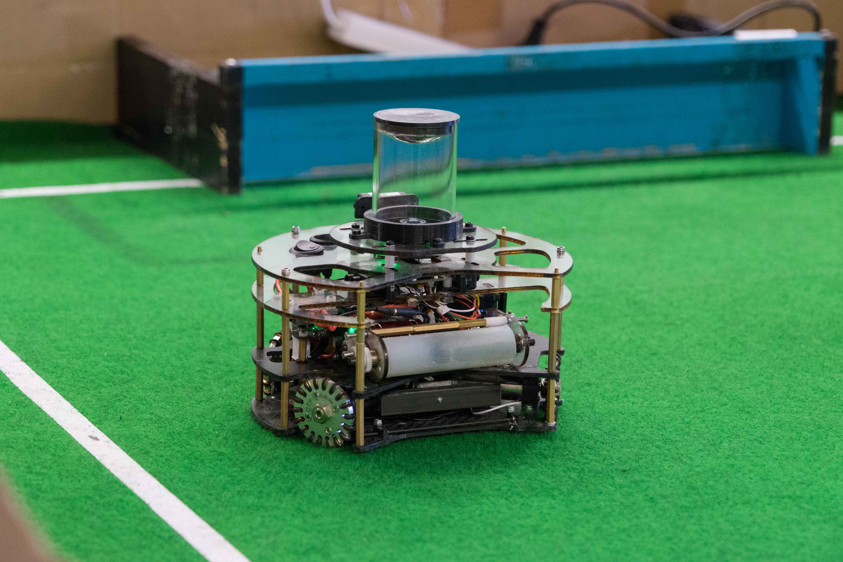
ROBOT STRUCTURE
LAYERS:
FG&B has produced two identical robots. We utilise a 4-levelled structure which deals with (from top to bottom):
Logic and motor switches, 360⁰ camera assembly
Electronic Speed Controller, front & side LIDARs
Microcontrollers, XBee inter-robot communication, power circuitry, motor controllers, IMU and backspin assembly
Motors, light sensor array, ball handling, battery housing, solenoid, solenoid power PCB and the kicker assembly
The plates for each level are made of laser-cut polycarbonate plates for the top two, or water jet cut carbon fibre plates on the bottom
The design also features 4 custom PCBs and 3D printed components
This design allows for easy disassembly and reassembly
1.
2.
3.
4.
Notes:
cooper

Slide 5
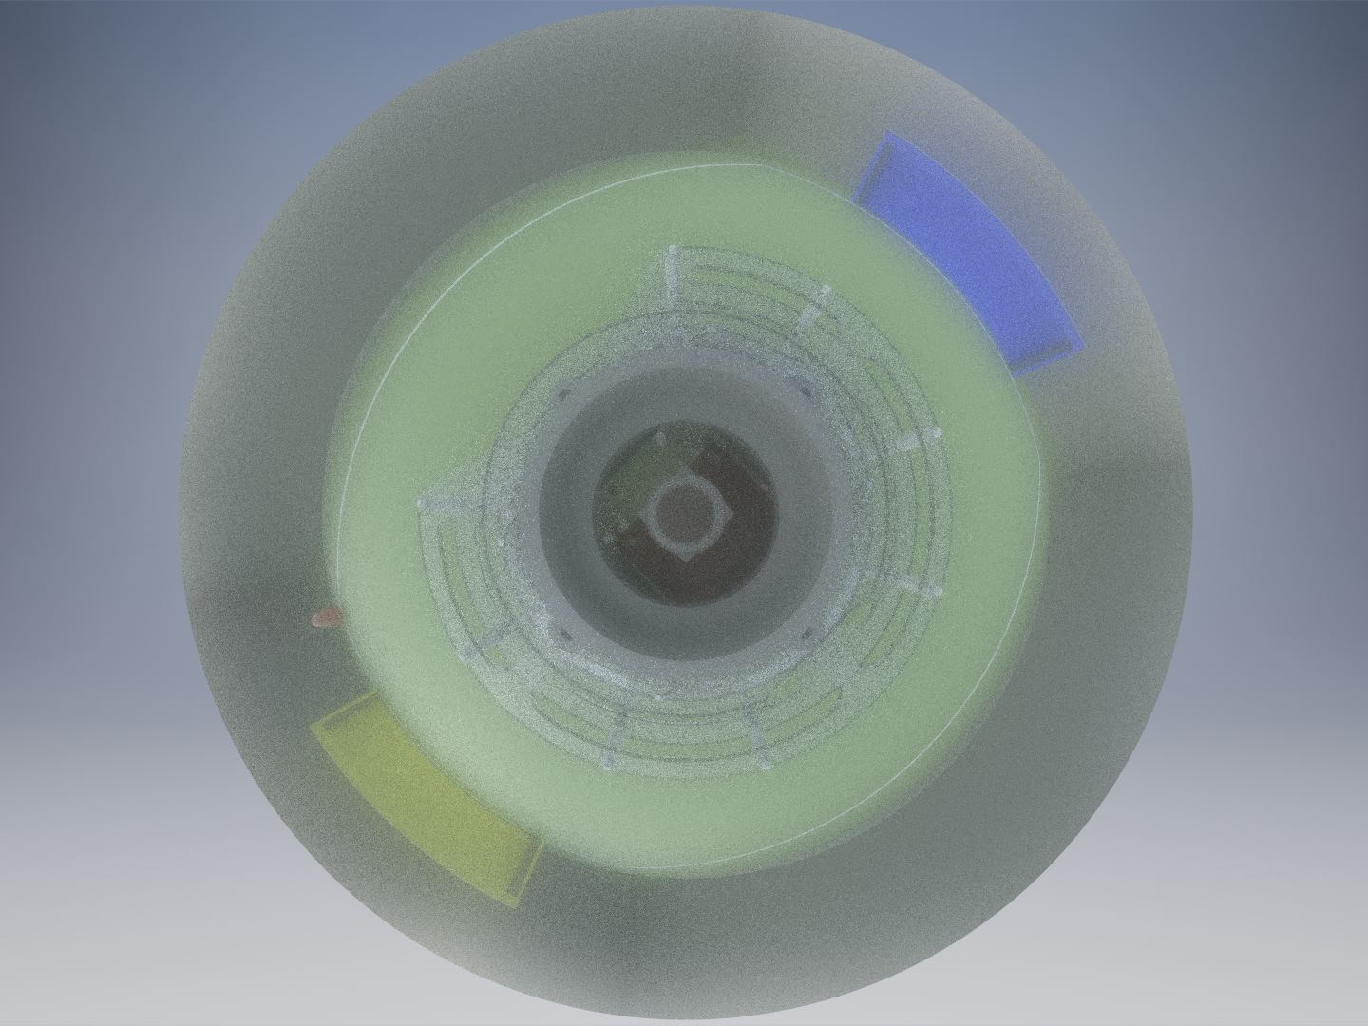
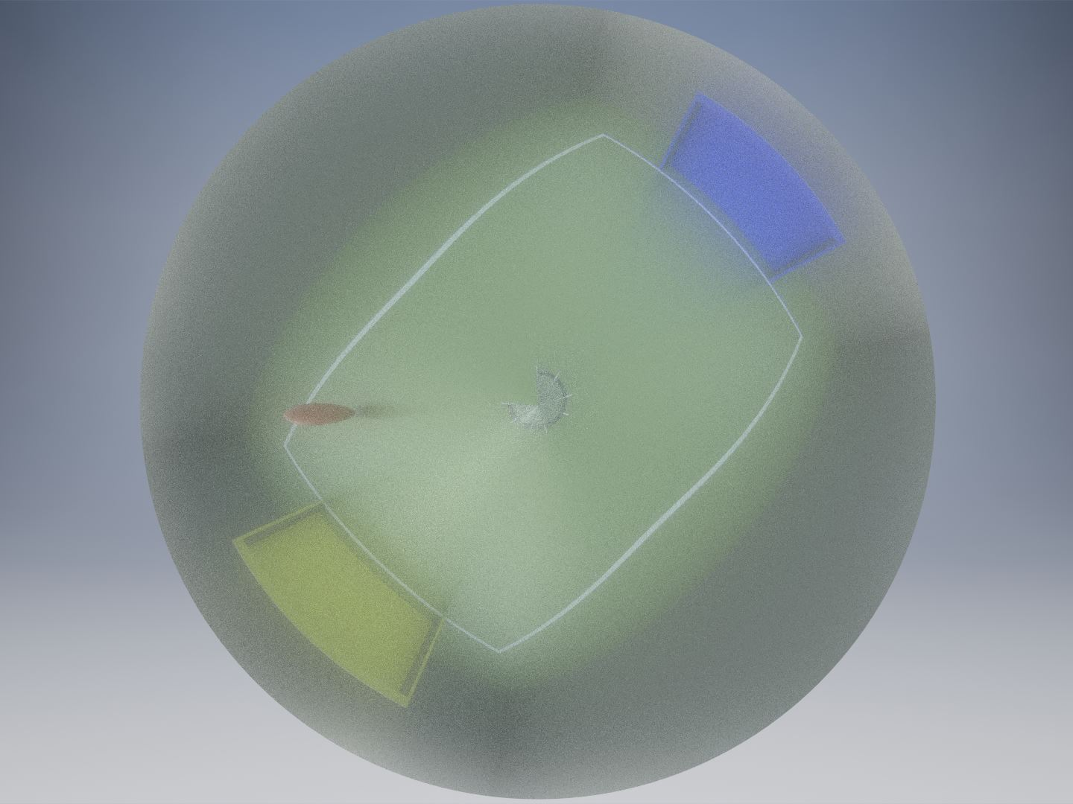
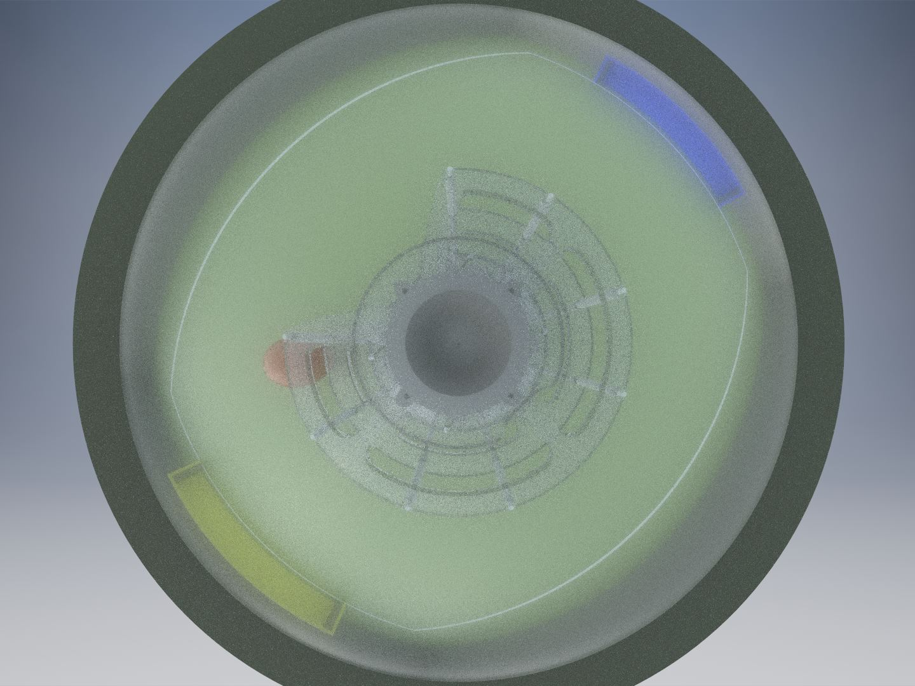
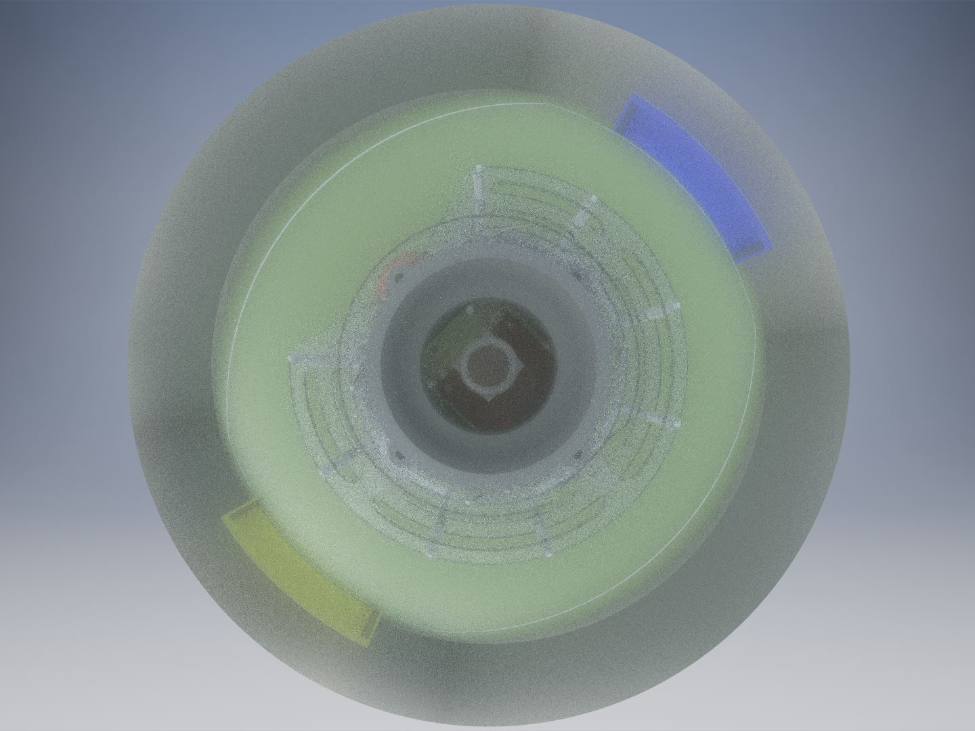
MIRROR MANUFACTURING
The mirror for FG&B’s 360 degree camera was designed by testing a number of different shapes using Autodesk Inventor
The mirrors were placed in the model of the robot placed on a soccer field, and the camera’s view was rendered showing what each shape would result in on the actual robot
We use a 135 degree lens on the Open MV
We tried many different ways to manufacture the custom mirror shapes
Many didn’t mould properly or the reflective surface would blur when heated
Manufacturing Process:
The final mirror shape was 3D printed
Then a uPVC mirror was heated and moulded over this piece
This formed the final mirror shape
Spherical Mirror
Conical Mirror
Early Design Parabola Mirror
Final Design Parabola Mirror
Notes:
cooper

Slide 6
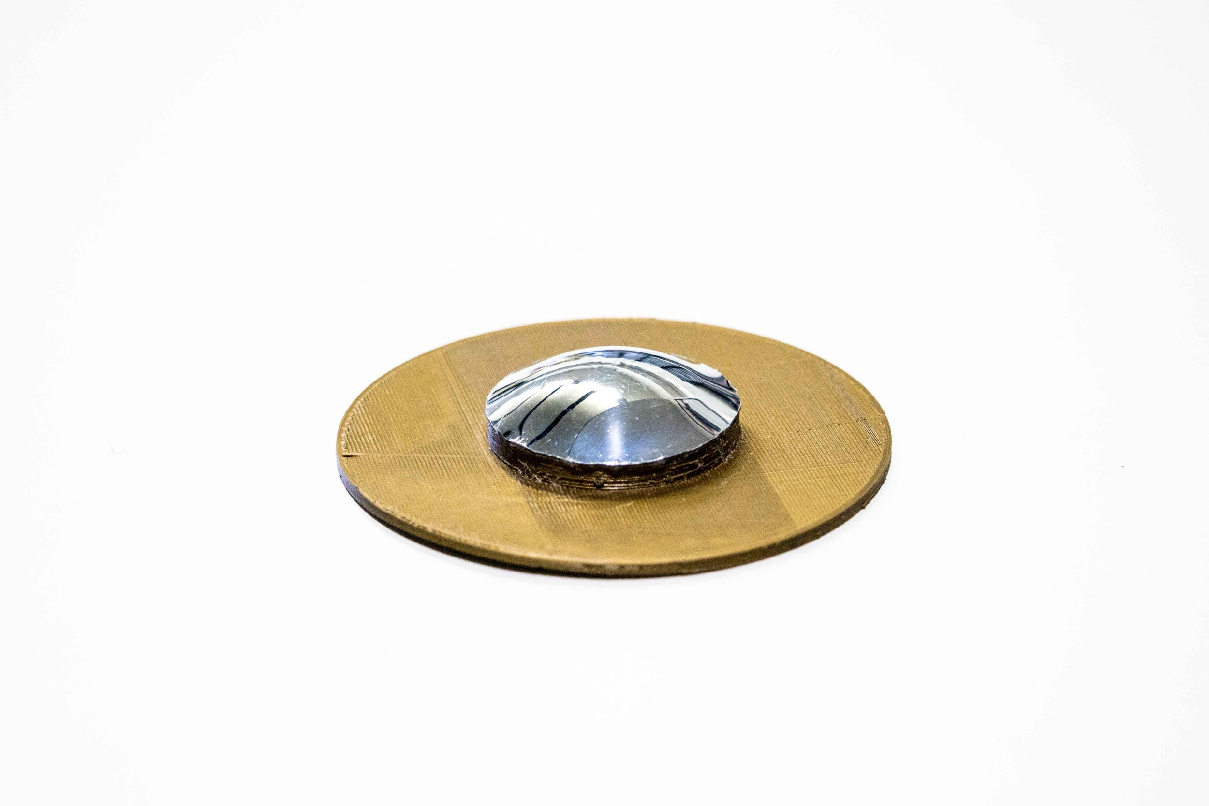
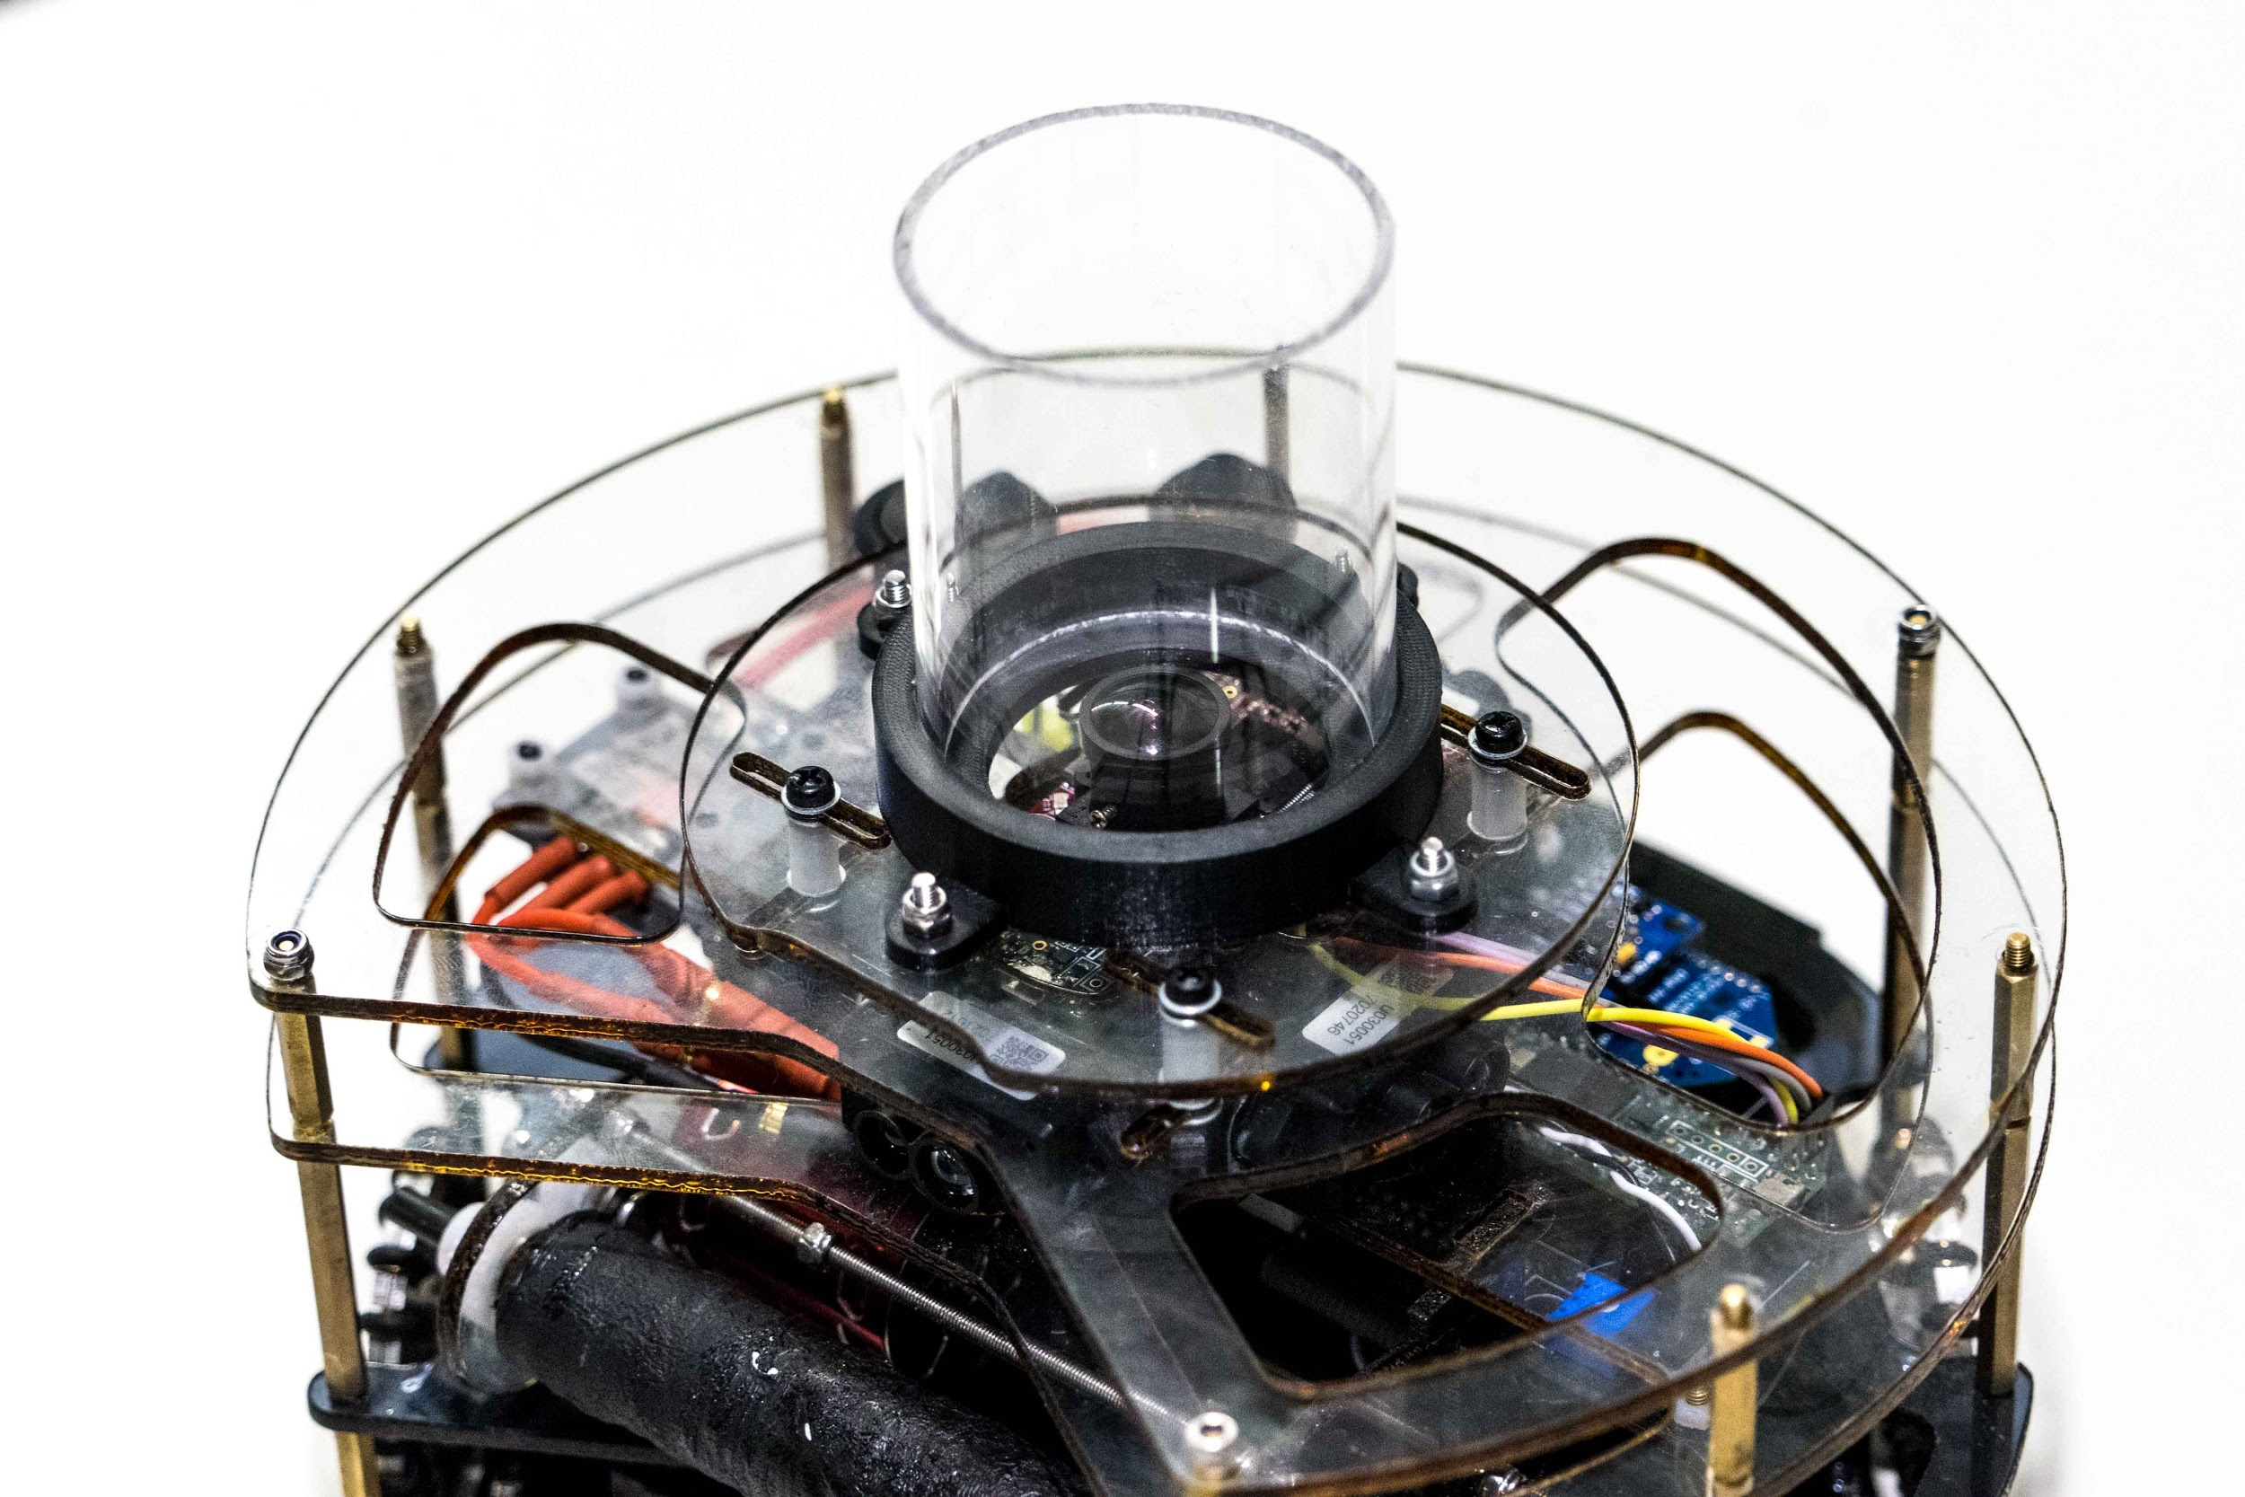
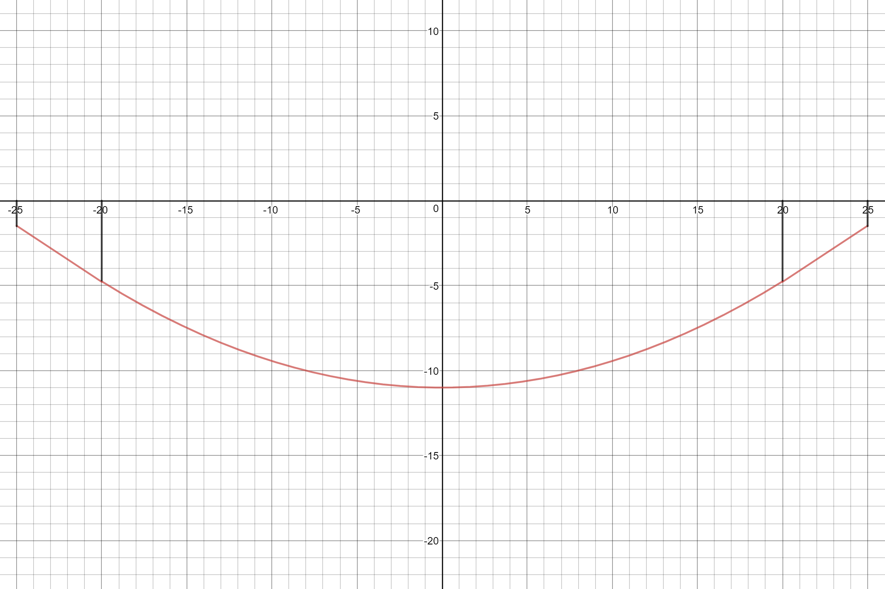
CAMERA ASSEMBLY
The Acrylic cylinder and mirror top can be moved relative to the camera
This is used so that the goalie can see further up the field as the camera is offset from the mirrors centre
The final shape was decided to be a parabola
Turning point at (0mm,11mm) and a derivative of tan(32°) at an 𝔁 value of 20mm. From 𝔁 of 20mm, to the edge of the mirror (𝔁 of 25mm) is a straight line with the gradient of tan(32°).
This shape was chosen as it gave a good balance between keeping distant objects large enough to be detected
also allowing good tracking close to the robot
Also prevented the robot from seeing over the walls, removing a large amount of interference
Custom Mirror Shape (Red Line) (Above)
Notes:
cooper

Slide 7
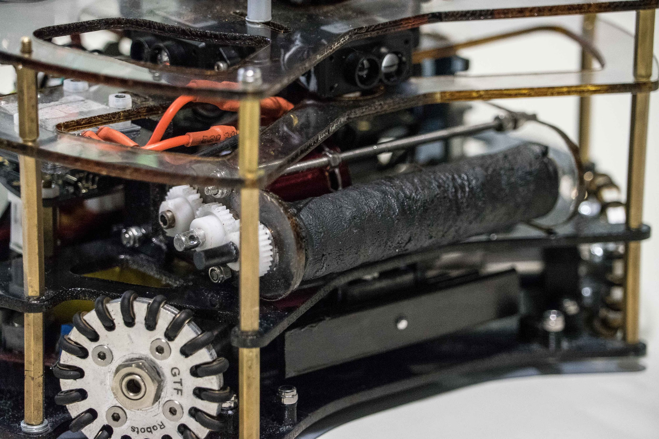
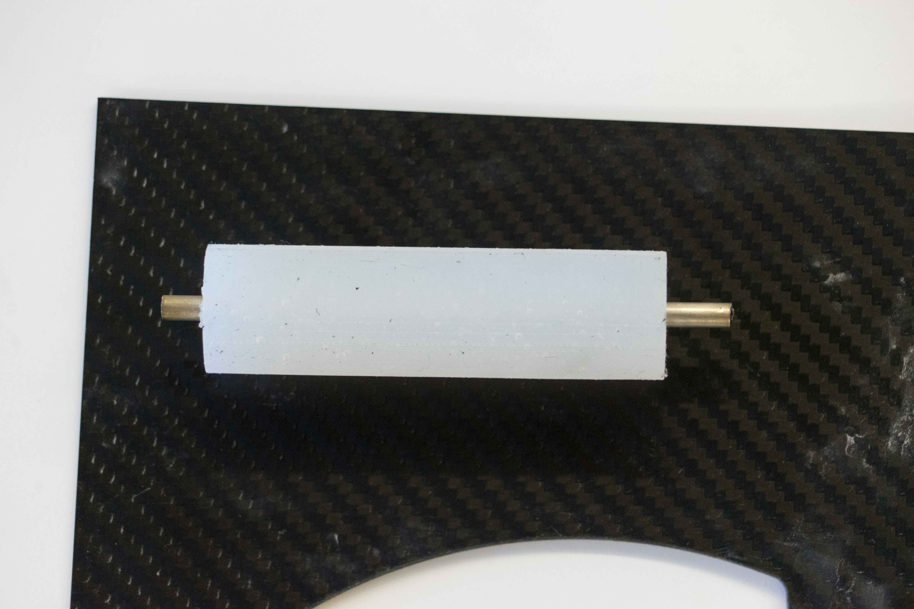
BACKSPIN & SOLENOID ASSEMBLY
The dribbler bar is powered by a high speed drone motor and ESC
This was made from a 3D printed mould, that silicon resin was poured into
A carbon fibre rod was also inserted into the mould for the silicon to wrap around
A custom silicon backspin was made as it was the only material that had enough grip with the ball & could withstand high rotational forces from high rpm of drone motor
Solenoid is powered by a custom PCB and high voltage converter
Kicker plate is a carbon fibre strip
This was due to other materials not being durable enough
Dribbling and manoeuvring the ball allows the striker robot to navigate even advanced goalie robots and hide from other strikers
Extensive testing was done to ensure that the robot moves at just the right speed and angles to ensure retention of the ball.
Backspin & Kicker Assembly (Above)
Silicon Backspin (Below)
Notes:
cooper

Slide 8
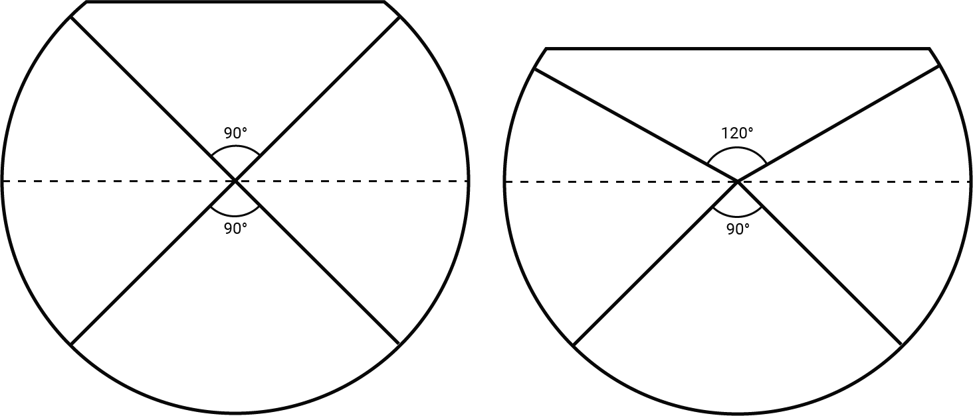
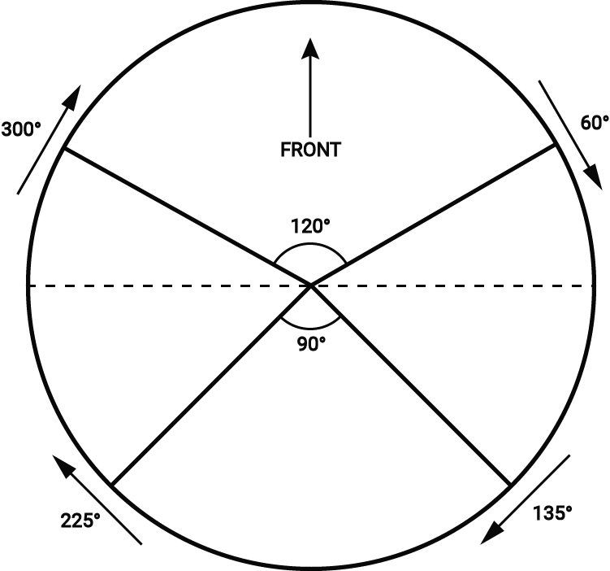
Motor Mechanics
For movement, 4 motors located on the 45 degree diagonals are the best option as this arrangement allows both the forwards and sideways speed to be maximised.
115mm
160mm
By spreading the front two motors to 60 degrees from the centreline, the capture zone of the robot can be made significantly larger. This slight tradeoff in sideways speed is outweighed by the significantly better ball control.
double motorPWM = (cos(((angleOfMotor + 90 - angle) * angToRad)));
int motorSpeed = (motorAPWM * scaledSpeed) + rotation; //Ensures that the pwm does not exceed 255
The final motor angle design (shown above) has the motors aligned to allow fast forwards and sideways movement.
The above code is used to calculate the value to write to the PWM input of each motor controller, and also allows the robot to move on any angle. The addition of a rotation constant to the speed of each motor allows the robot to overlay both movement in any direction, as well as any rotation.
Notes:
cooper

Slide 9
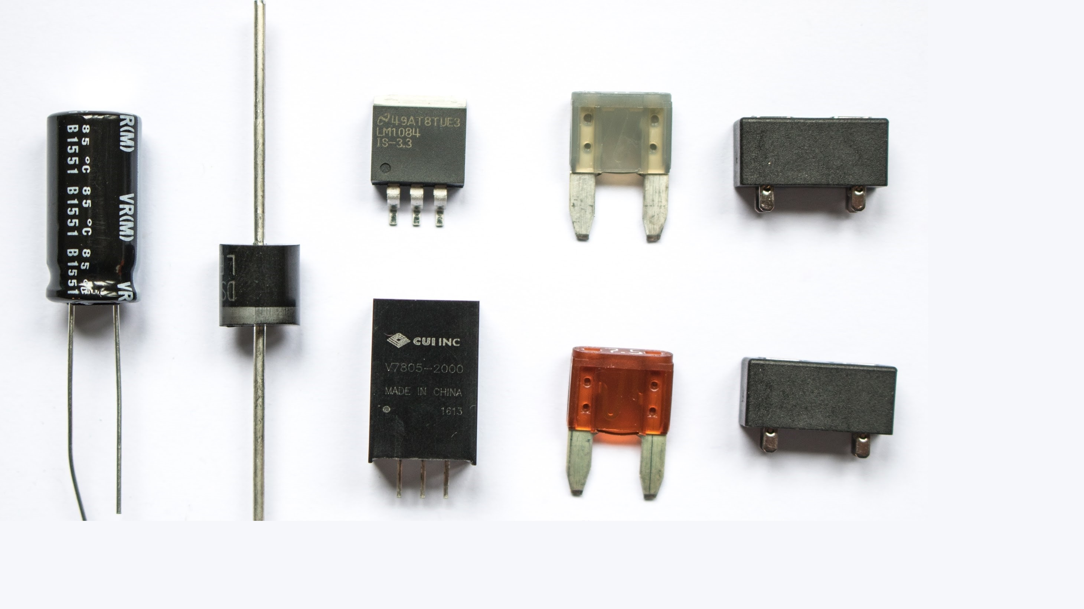
ELECTRONICS
Notes:
hulbert

Slide 10
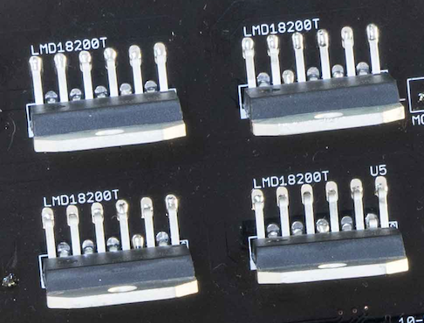
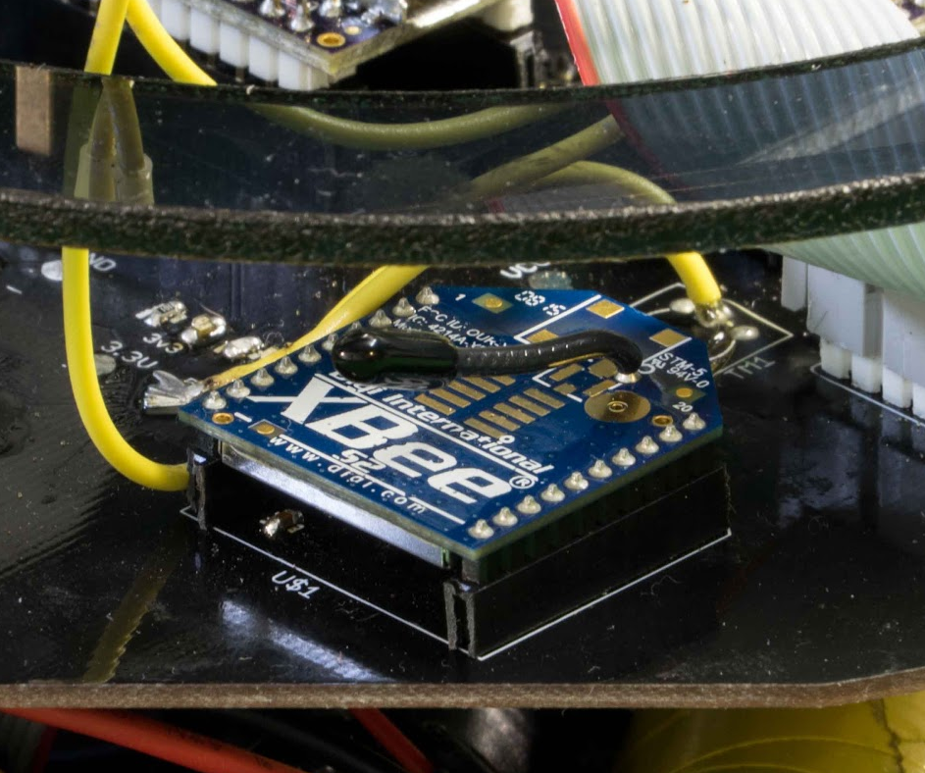
ELECTRONICS
Motor Controllers (Left)
TI LMD18200T motor controllers are used to convert digital microcontroller signals into analog motor voltages
They are used to control the speed and direction of the motors.
Xbee (Right)
Utilised for inter-robot communication
XBee radio module which transfers data wirelessly using the ZigBee protocol
Robots communicate strategies & tactics using these modules
When the goalie is ‘disconnected’ (e.g. for damage) the attacker will switch to goalie & defend until the other robot is turned back on
Using the Field Coordinate system (discussed later), the robots can ‘share’ the balls location
Motors
We use four, Maxon DCX19
At 16:1 gear ratio
Camera
Open MV M7
Uses a ARM Cortex M7 Processor
Notes:
hulbert

Slide 11
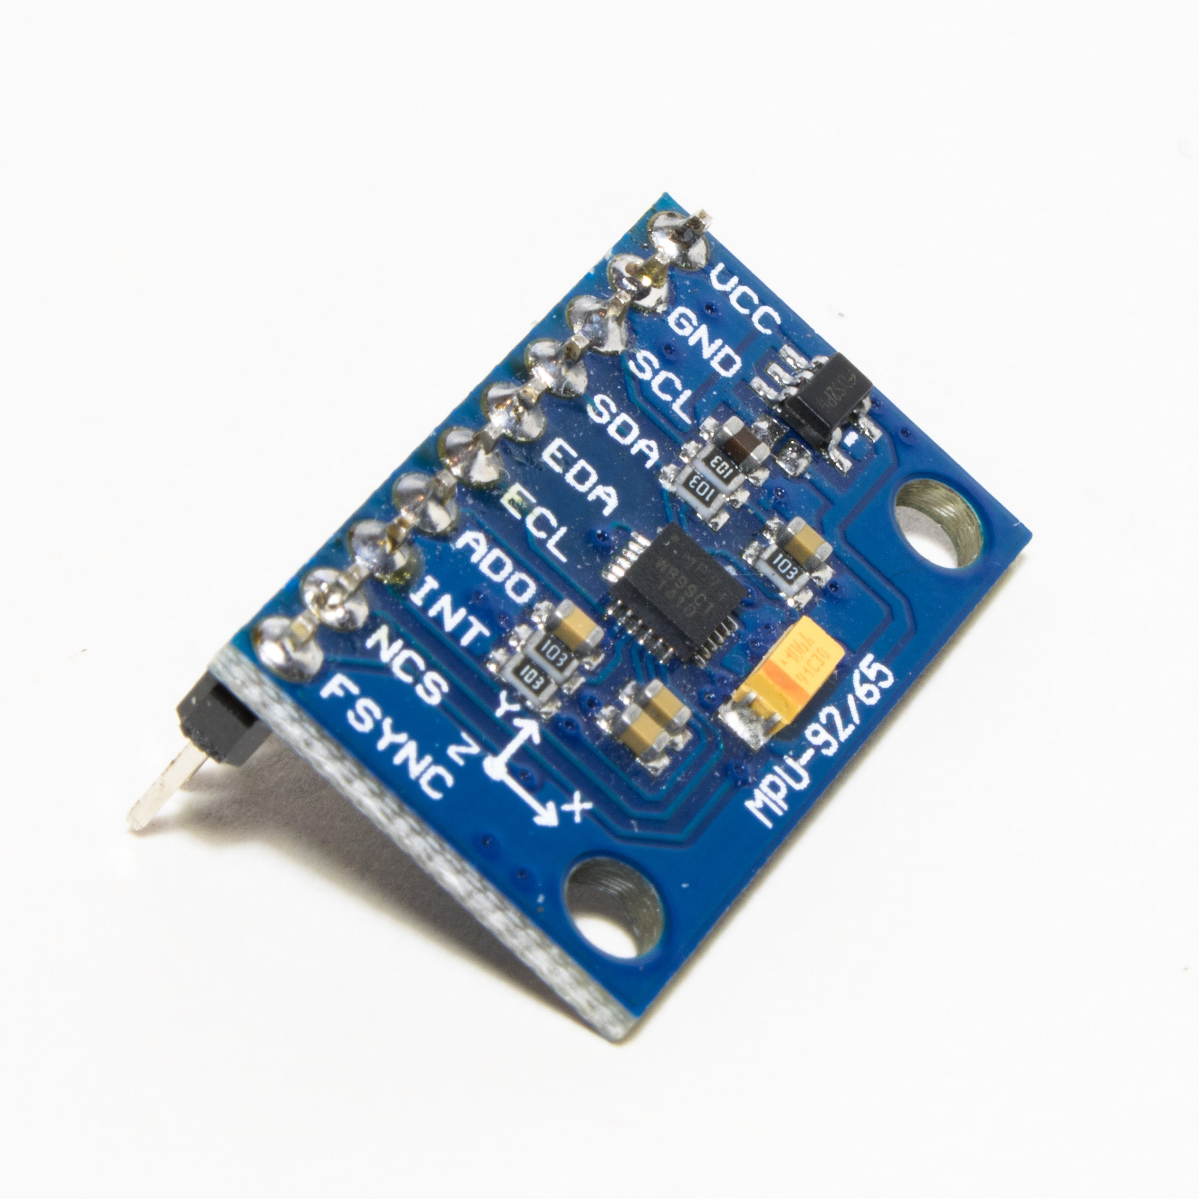
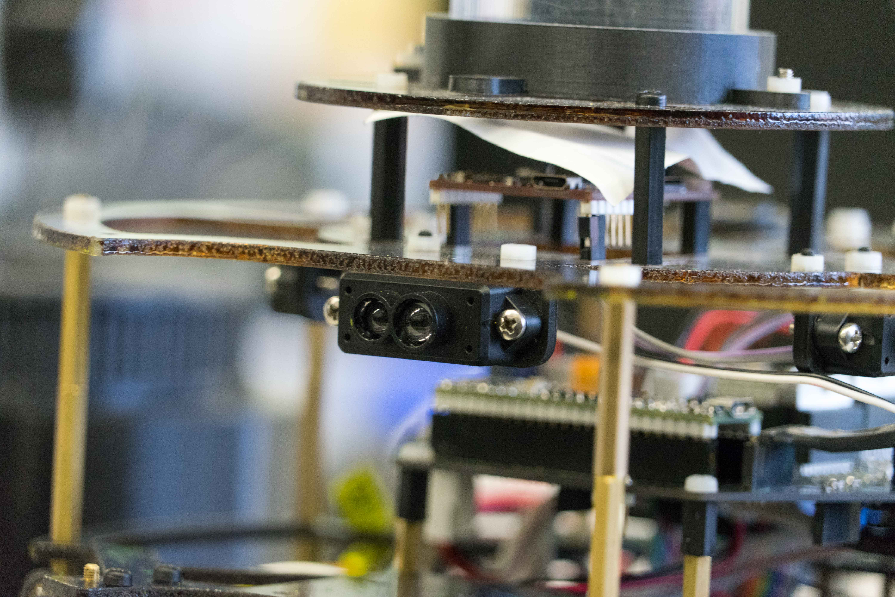
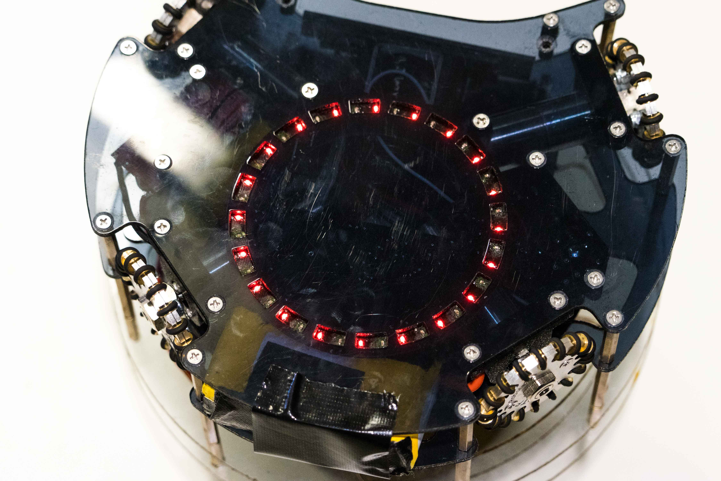
SENSORS
Light Sensors (Below)
20 Light sensors are arranged in a circular array
Each sensor contains a red LED and a phototransistor
Red was chosen because it allows the greatest amount of contrast between the green mat and white line
Sends analog signals to microcontrollers
IMU (Right)
An inertial measurement unit (MPU9250) is used to calculate the robot’s heading
IMU is a magnometer, accelerometer & gyro
LiDARs (Right)
LiDARs are laser range finders
Four LiDARs were used to calculate distances to edges of the fields
LiDARs were positioned to face forward, backward, left & right of the robot
The LiDAR values are used to calculate the robot’s position on the field in conjunction with the camera field position calculations
Notes:
hulbert

Slide 12
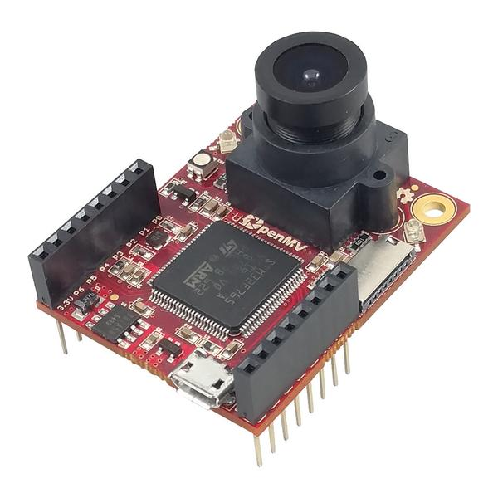
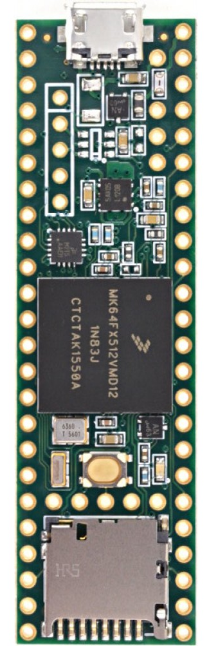
ELECTRONICS
MICROCONTROLLER STRUCTURE
Microcontrollers
There are two Teensy 3.5 microcontrollers & one ARM Cortex M7 on each robot:
LiDAR Slave (Teensy 3.5): Dedicated to reading the four LiDARs
Master (Teensy 3.5): Pulls data from the LiDAR & Camera Slaves and all other sensors
Camera Microcontroller (ARM Cortex M7): reads and interprets data from the camera
Master then performs calculations and writes to motor controllers
Camera Slave
Master Teensy
Camera
An OpenMV camera is used to track the goals & ball. The camera faces upwards towards a parabolic mirror, allowing full 360 degree vision.
Ideal for goal tracking since it sends processed object data (colour, position and size)
Requires very little processing power from the microcontroller
The native camera has a field of view of 115°, a 320x240 pixel image sensor, and communicates over Serial
LiDAR Slave
Other Sensor Raw Data
(Light & IMU etc)
analog write to motor controllers
Notes:
Hulbert

Slide 13
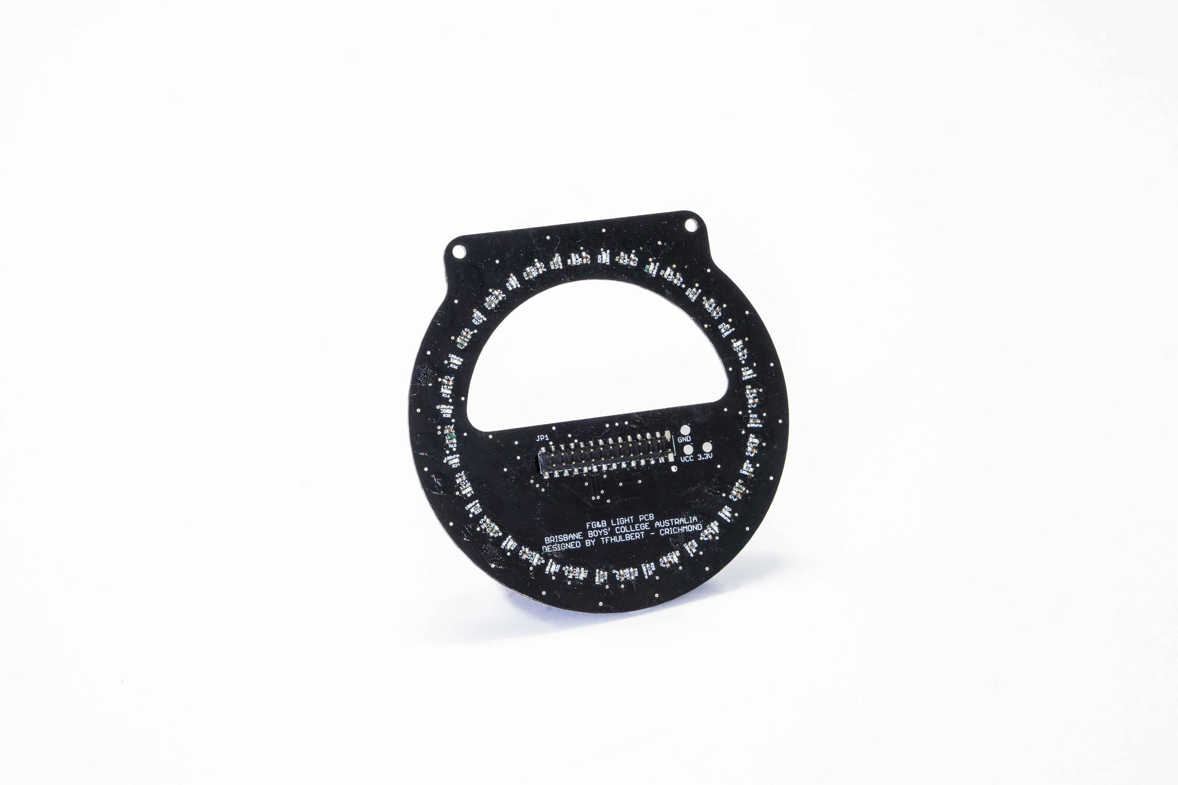
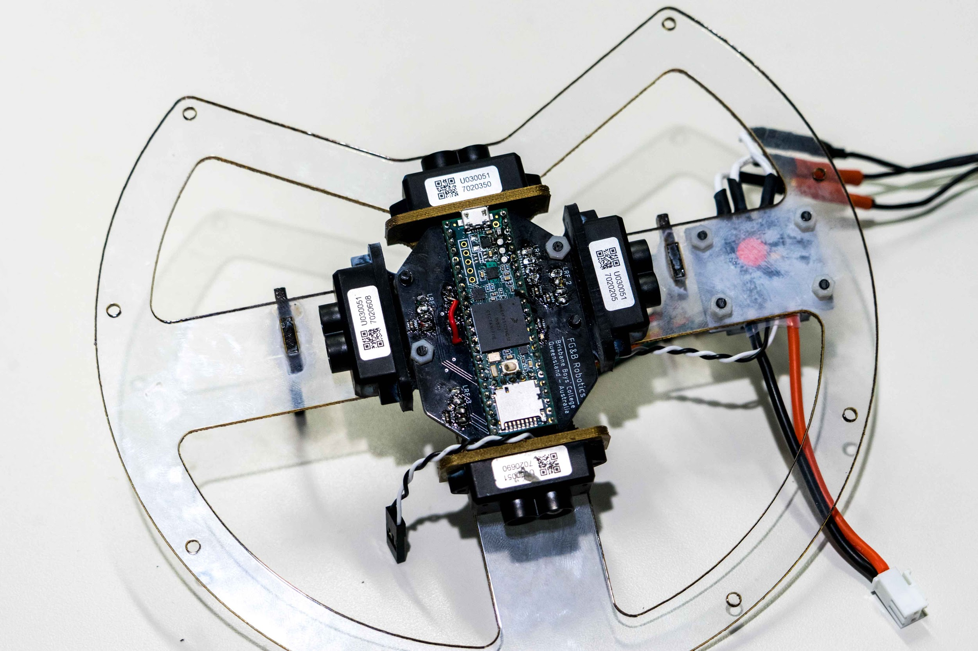
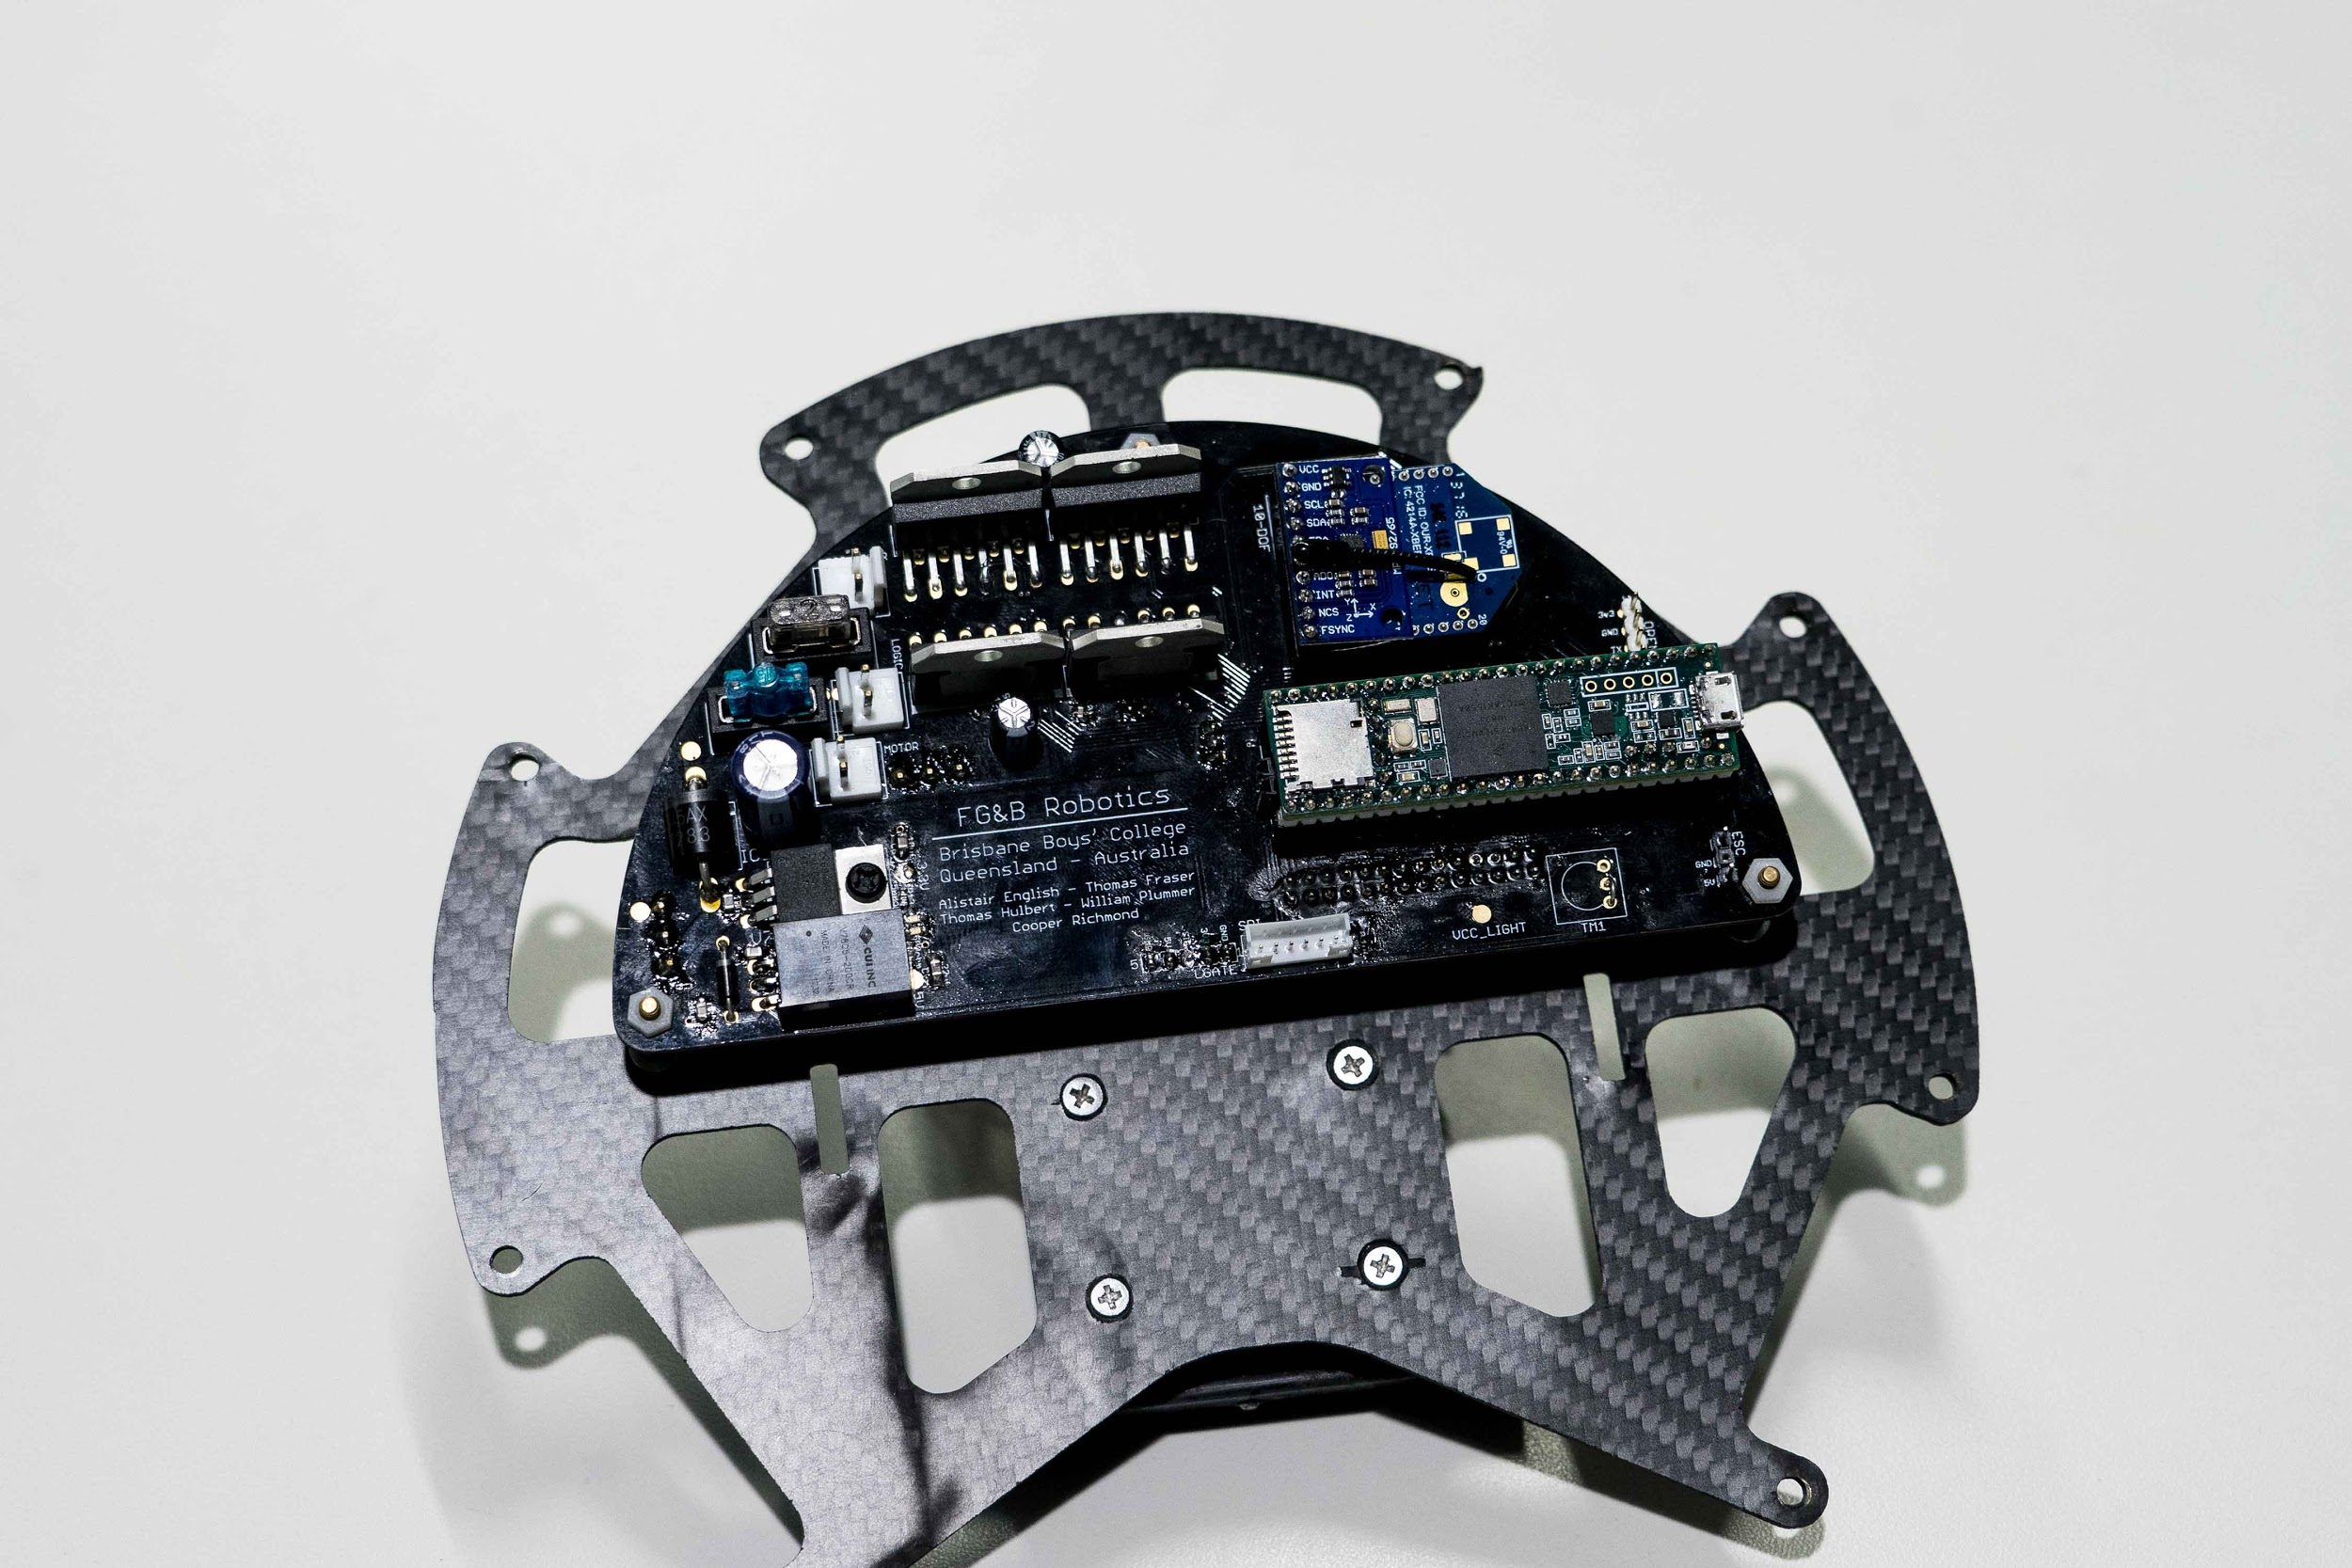
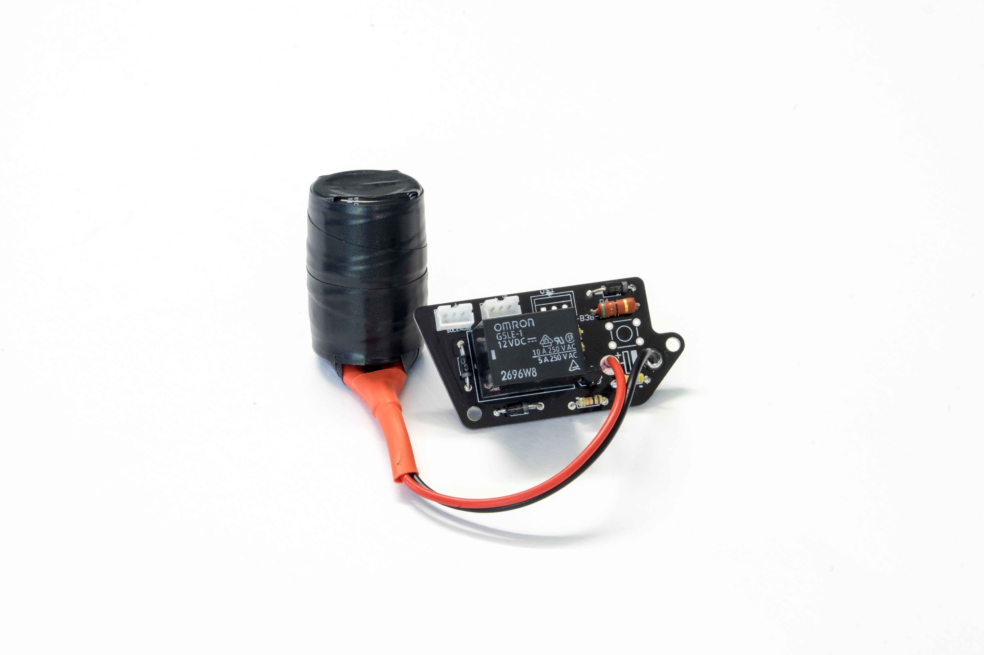
PRINTED CIRCUIT BOARDS
LIGHT PCB
This contains the 20 light sensors
PCBs were utilised to connect all electronic components together in a way that reduces errors and messy wiring, as well as providing a base for all components. This makes the task of understanding the circuitry and debugging very easy.
LiDAR PCB
Houses the four LIDARs and dedicated processor
MAIN PCB
This contains the IMU, microcontrollers, power circuitry, xBee boards and motor controllers.
Kicker PCB
This contains high voltage circuitry to drive the solenoid
Notes:
hulbert

Slide 14
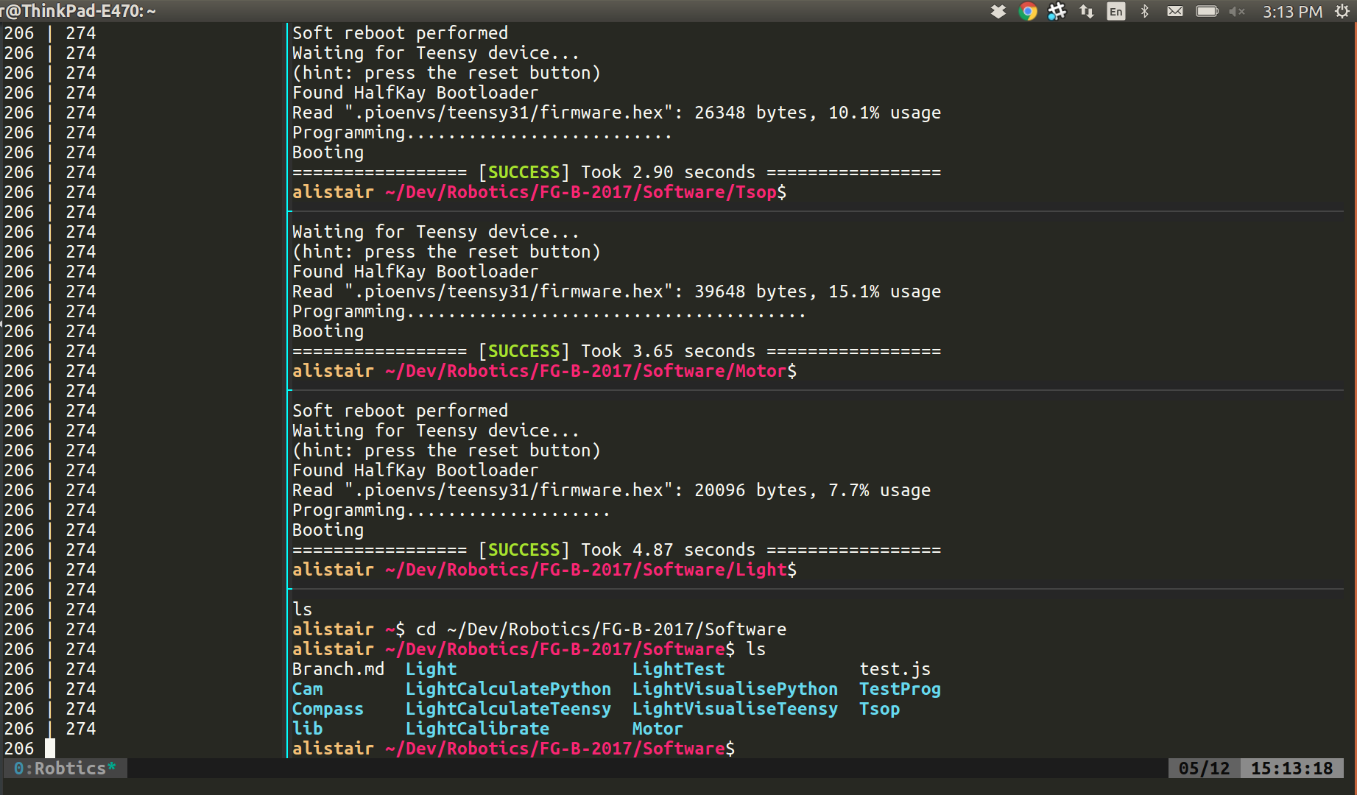
SOFTWARE
Notes:
fraser

Slide 15
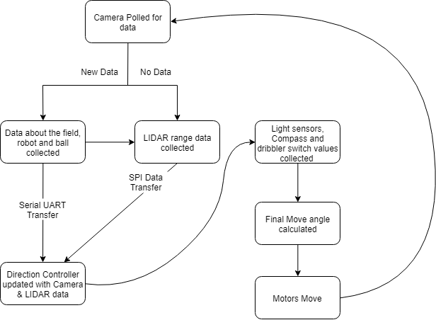
PROGRAM STRUCTURE
Programmed in C++
PlatformIO Arduino compiler
Python along with the OpenMV IDE to upload to the OpenMV7 camera
Use of C++ libraries consisting of a .h (header) and .cpp (c++) file
These libraries consist of smaller ‘chunks’ of code pertinent to a certain task
As an example, the Motor Controller library calculates the final directions and speeds to set each of our four motors to move in a certain direction.
Notes:
Fraser

Slide 16
BALL TRACKING & DETECTION
The angle that the robot moves on is determined by frame analysis from the OpenMV 7 camera module and custom 360 degree modifications. Each frame received from the camera is analysed for specific colour relating to the ball, goals and field markers. The angle of the ball is then found by calculating the atan of the x and y locations of the object in the image. The strength is then calculated by finding the magnitude of the hypotenuse of the x and y locations.
#Python
x = -(ball.cx() - (img.width() / 2)) #Calculate Coordinates of Ball
y = ball.cy() - (img.height() / 2)
angle = (atan2(y,x) * (180 / pi) - 90)%360
strength = sqrt(x**2 + y**2)
Once all objects have been calculated and an angle and strength have been calculated, the data is transferred over to the ‘Master’ teensy where other calculations including the orbit occur.
//Pseudocode
if angle.inRange(300, 60):
return angle < 180 ? (angle + (angle/100 * 75) : (angle - ((360-angle)/100 * 75))
else:
return angle < 180 ? (angle + 50) : (angle - 50)
Notes:
Fraser

Slide 17
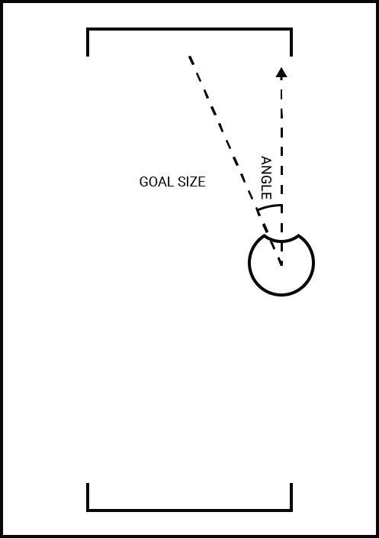
GOAL DETECTION & TRACKING
Using the 360 degree camera, the robot is able to track the goal. The camera sends data about objects: position and size.
The robot picks 2 objects to use as the attacking and defending goals.
- Objects that are too small are rejected
- Only the colour of the relevant goal
(for attack or defence) is used
- Only the largest block of each required colour is used
Then angle and distance are calculated using a coordinate system.
-
//Pseudocode
x = -goalCentreX - (imageWidth / 2)
y = goalCentreY - (imageHeight / 2)
goalAngle = (atan2(y,x) * RADIANS_TO_DEGREES - 90) % 360
goalSize = 2*(sqrt(x^2 + y^2))
Notes:
fraser

Slide 18
INNOVATIONS
Notes:
fraser

Slide 19
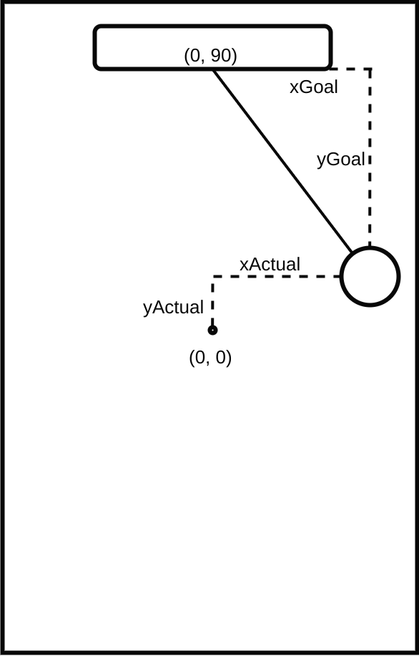
FIELD COORDINATE SYSTEM
Using the 360 degree camera, the robot is able to detect both the angle and the distance to the attacking and defending goal.
Using this data, the robot is able to calculate an estimate for its position on the field in terms of an x and y coordinate.
For our system, (0, 0) is defined as the center of the field with positive x extending to the right of the robot and positive y extending forwards. The units are in centimeters, thus for example the front right corner would is (60, 90).
The calculation is shown below:
//Pseudocode
int distance = calcDistance(areaA);
int xGoal = distance*sin(angToRad*angleA);
int yGoal = distance*cos(angToRad*angleA);
int xActual = ATTACK_GOAL_X-xGoal;
int yActual = ATTACK_GOAL_Y-yGoal;
Notes:
fraser

Slide 20
DEFENCE
The key part of the defender is its use of the coordinate system. By using the same logic as before, the robot also calculates the x, y position of the ball. Then, the robot moves itself to the same x position as the ball whilst remaining on a predefined fixed y value.
The goalie also has a “surge” ability, which involves moving forward to the ball when it is close in front of it. This allows the robot to attack the ball and brings the ball into the capture zone, enabling the goalie to kick it out of the goal area.
//Pseudocode
int targetX;
int targetY;
int allBallX = getAllBallX();
int allBallY = getAllBallY();
if(allBallX != 65506){
targetX = allBallX;
if(abs(allBallX-currX) < SURGE_X && (allBallY-currY < SURGE_Y && allBallY-currY > 0 && allBallY < SURGE_MAX_Y)){
targetY = allBallY;
}
else{
targetY = GOALIE_Y;
}
}
else{
targetX = 0;
targetY = GOALIE_Y;
}
if(targetX > GOALIE_X_RANGE) targetX = GOALIE_X_RANGE;
if(targetX < -GOALIE_X_RANGE) targetX = -GOALIE_X_RANGE;
goToCoords(targetX, targetY);
Notes:
fraser

Slide 21
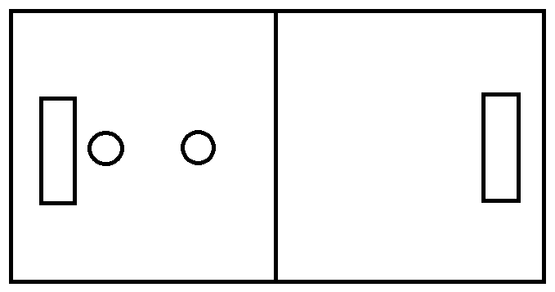
STRATEGIES
Defensive Repositioning:
When neither robot can see the ball, both the goalie & striker robots will defensively centre on the field, as shown:
Our robots have multiple tactics & strategies developed for different circumstances, our main ones being:
Communication of Ball Location
Defensive Repositioning
Striker to Goalie, Robot Role Switching
Communication of Ball Location:
One problem that we encountered, is that the goalie cannot see the ball if it is on the other half of the field. This often occurs when the striker robot captures the ball and dribbles it up the field. So, using the Field Coordinate System, the striker robot can calculate its position on the field & the balls location and send the balls location to the goalie via the xBee communication modules. This allows the goalie to guess where the ball will approach from & give it more time to position itself in front of the goals.
Striker to Goalie, Robot Role Switching
The two robots both know if they are connected via the xBee module. If the goalie robot was to be taken off for damage, the xBee communication would be turned off too and hence, the striker robot would know.
From this, we had set it so that if this is to occur, the striker robot will assume defence and protect the goals until the goalie is back on the field.
Notes:
fraser

Slide 22
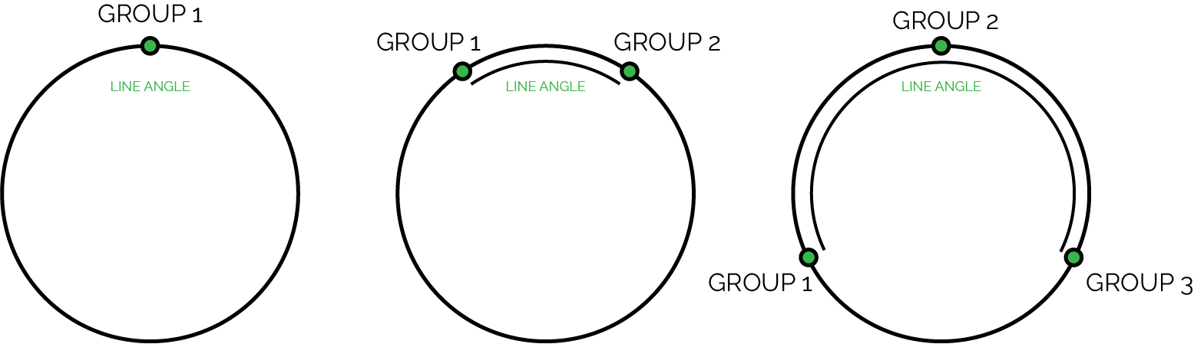
LINE DETECTION
The robot detects the line by organising it into “clusters” of sensors around the array that are seeing the line,
and then uses these clusters to calculate a line angle and size.
Different calculations happen depending on the number of groups.
- 1 group: the angle is the angle of the group
- 2 groups: the angle is the midpoint of the smallest arc between the groups
- 3 groups: the angle is the midpoint of the arc connecting the furthest two groups through the third group
Notes:
cooper

Slide 23
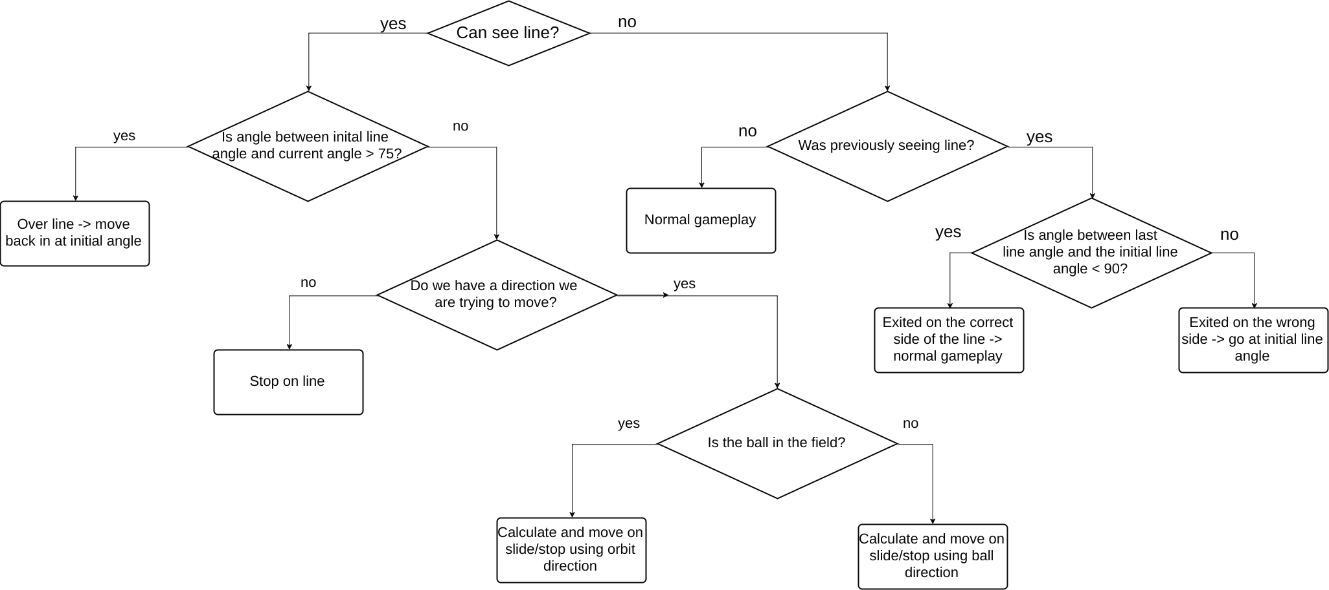
LINE TRACKING
The robot tracks the line’s position underneath it by keeping a track of the angle of the line. If the line angle is in the other half to the previous line angle, the robot knows it has crossed the line.
Notes:
Cooper

Slide 24
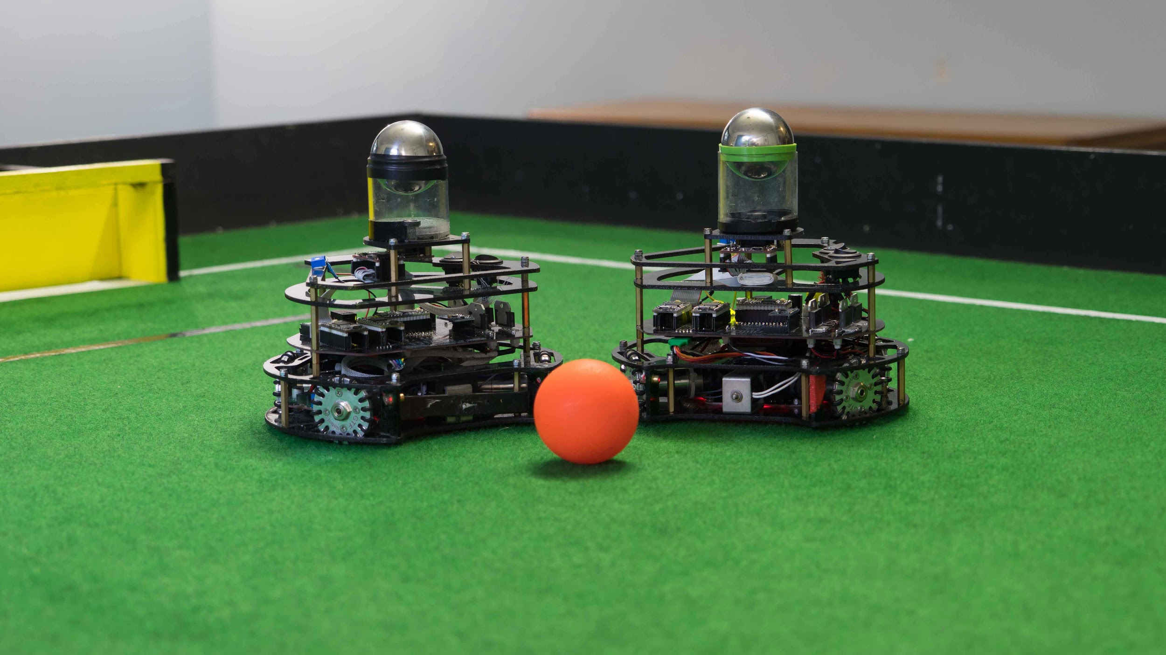
PROGRESS & IMPROVEMENTS
Notes:
will

Slide 25
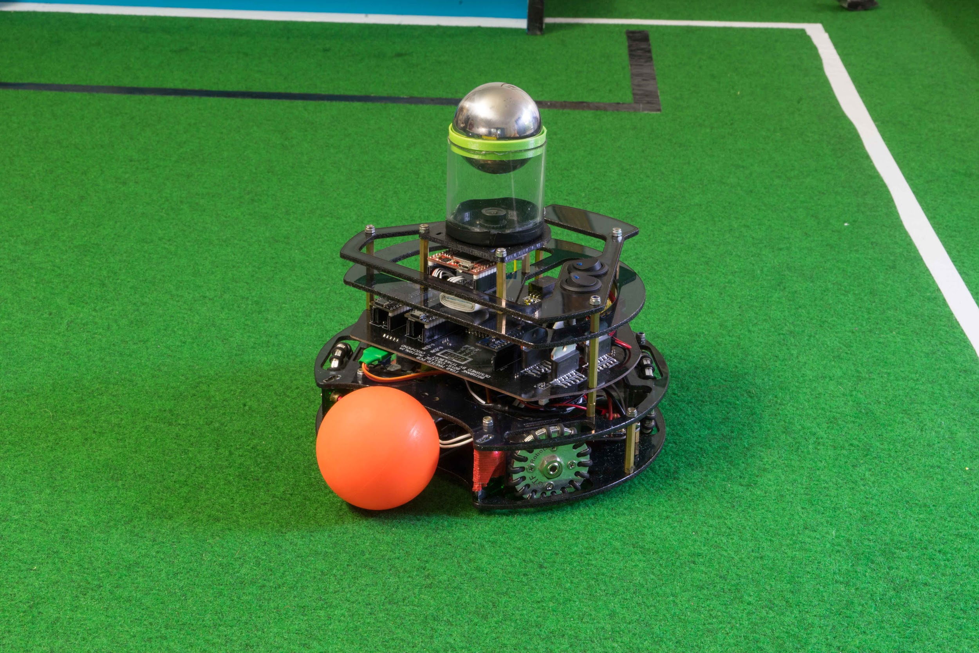
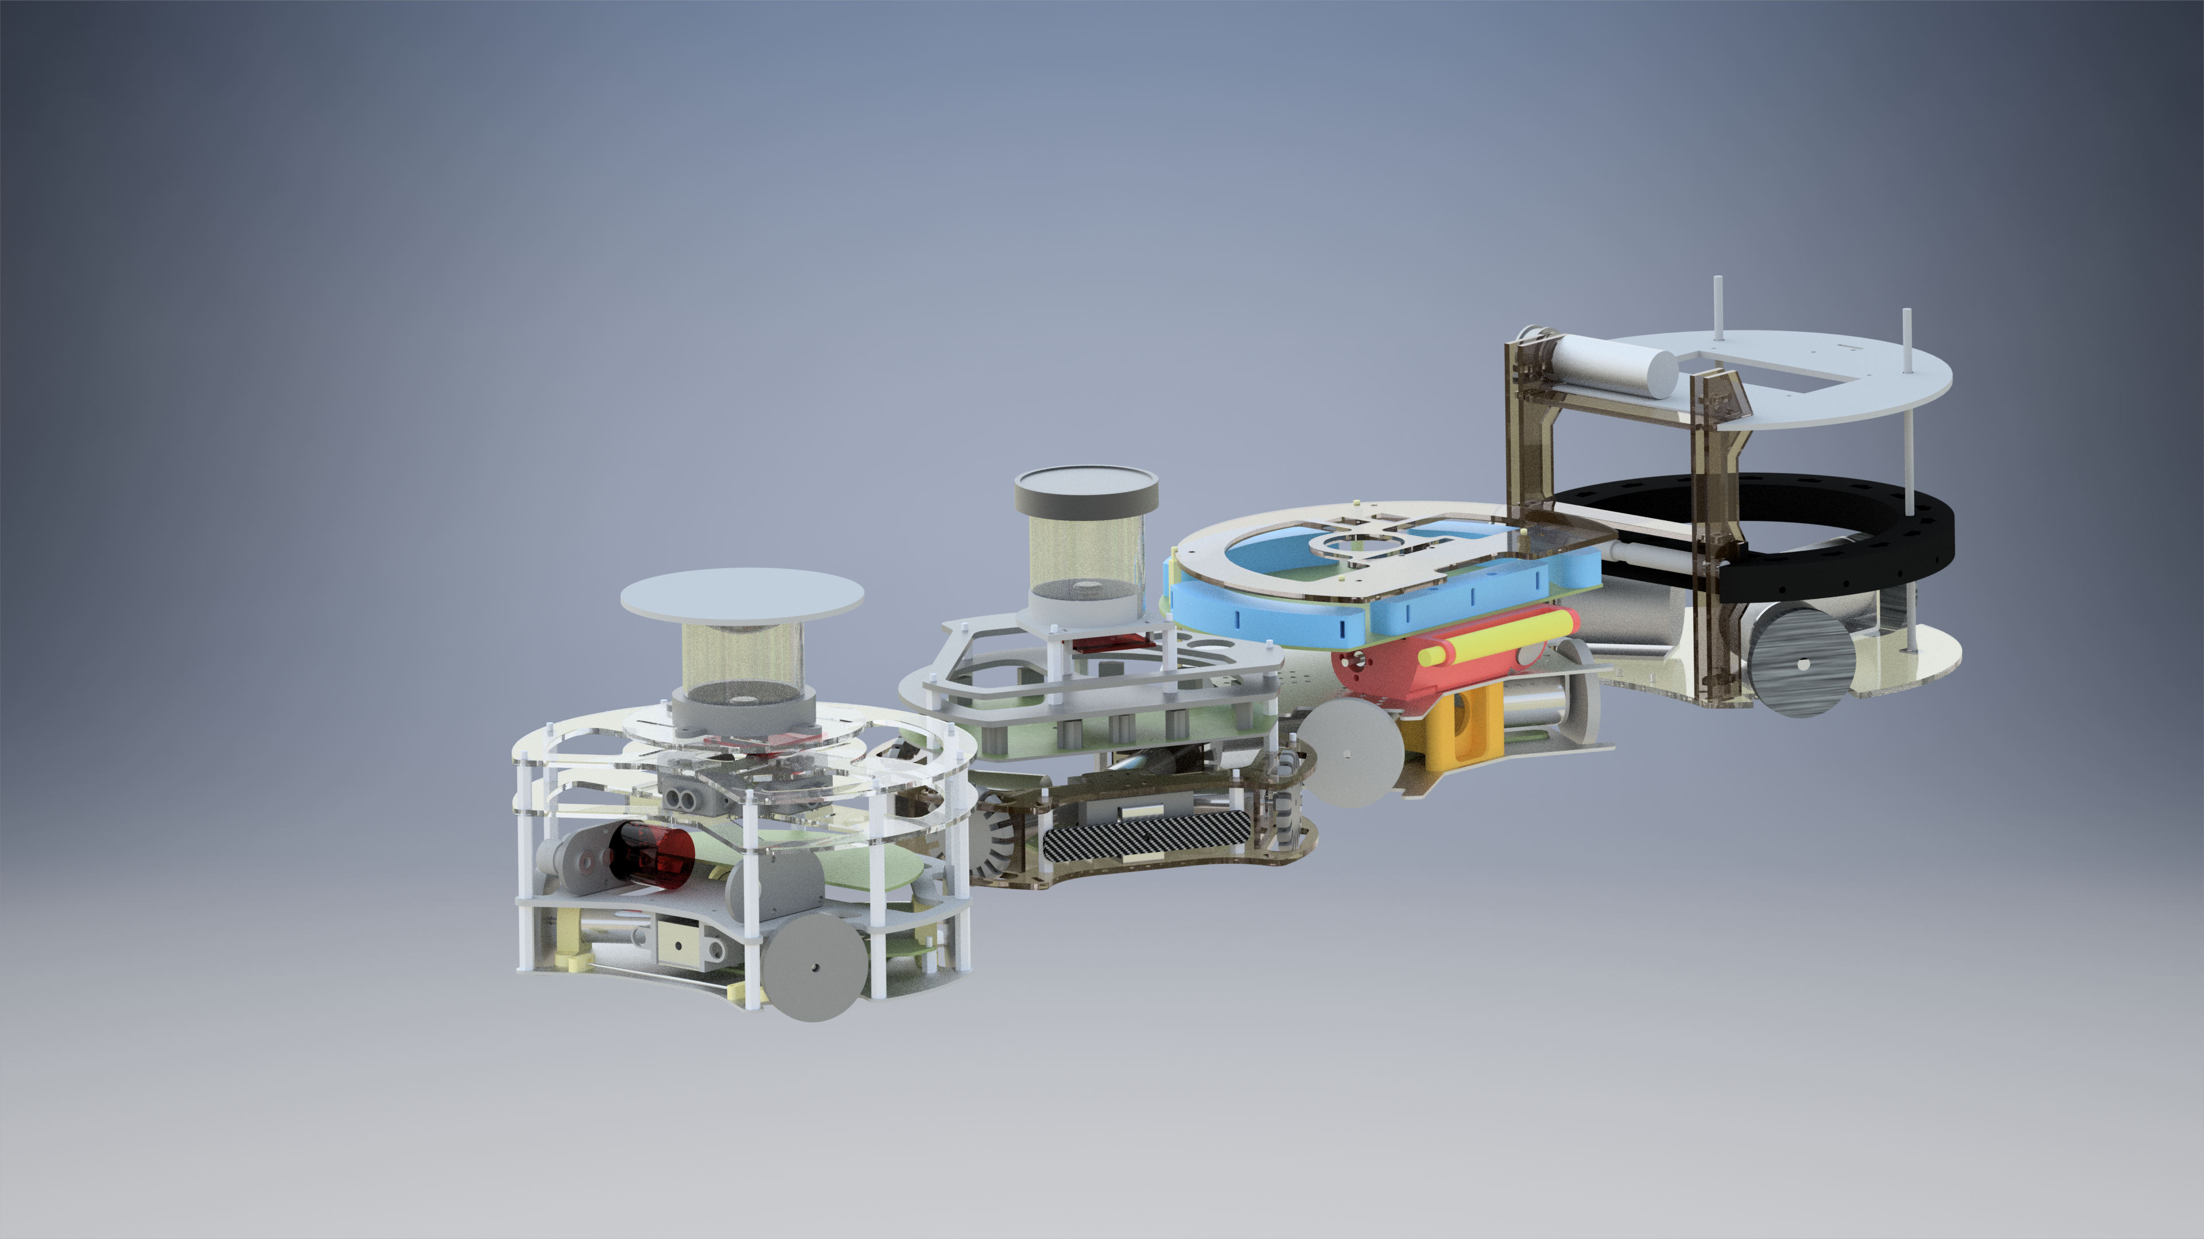
FEATURES RETAINED FROM 2017
Construction Materials
Laser cut polycarbonate top plates
High strength brass stand-offs
Simple construction for fast assembly & teardowns
Motors
Retained last years Maxon DCX19s but change the gearbox for more speed, less torque
Camera
Open MV M7 was retained
Found to be reliable and stable
Software was very good
FG&B’s 2017 Robot design (Above)
Motor Angles
Same angles as last year were used as it provides a good balance of ball capture zone, forward and sideways movement speed
Wheels
We continued to use GTF Robots’ wheels as they were very durable and provide ample grip
FG&B’s 2018, 2017, 2016 & 2015 Robot Designs in Autodesk Inventor (Above, Left to Right)
Notes:
will

Slide 26
PROGRESS
Printed Circuit Boards (PCBs)
Fourth iteration of master and light boards
Cost-effective and neat solution for very stable and reliable power
Main PCB no longer absorbing impact forces, has dedicated stand-offs
LiDARs
Four LiDARs were added to the robot this year
LiDARs were positioned to face forward, backward, left & right of the robot
The LiDAR values are used to calculate the field position
Motors
Four Maxon DCX 19 motors
New 16:1 gear ratio
Slightly faster rpm for slightly less torque than last year’s motors
Mirror
New custom made Parabola mirror instead of old hemisphere
To maximise the range and accuracy of the camera feed
Custom Backspin & Solenoid
Use of dribbler allows for advanced tactics
Able to hold & hide the ball from opponents’ robots
The dribbler bar even when off still drastically improves ball retention in the capture zone
FG&B’s 2018 Robot design (Above)
Notes:
will

Slide 27
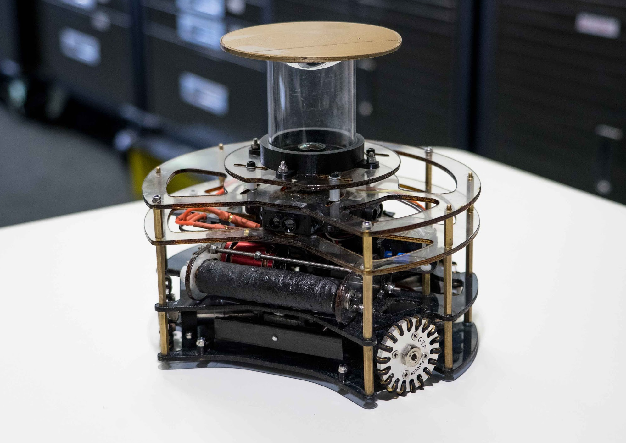
FUTURE IMPROVEMENTS
Better Camera & Lens
Having a much more powerful camera and lens would be a major performance increase
Since robots’ major weakness is the short range that it can see the ball at.
More camera resolution results in easier identification of the passive ball at longer ranges
However, more powerful processor will also be required to analyse the larger pixel count.
Better Dribbler
Alternate gearboxes should be used to trade some of the currently excess speed for more torque
We found that the backspin could only run around 10% speed
Also when the backspin comes into contact with the ball, it slows down significantly.
Mirrors
Further testing of mirror shapes and manufacturing techniques will be done so that a better image can be produced.
FG&B’s 2018 Robot (Right)
Notes:
will

Slide 28
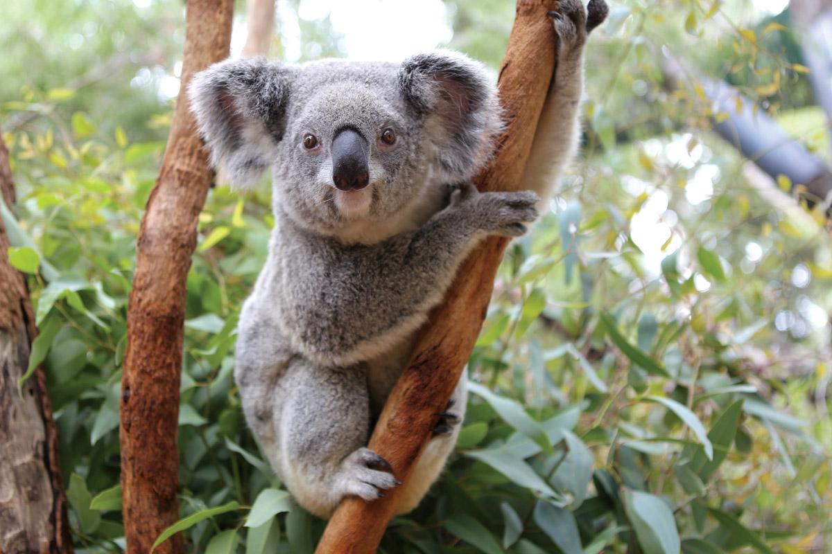
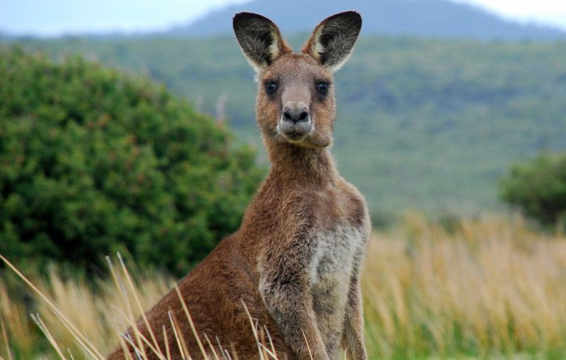
Goodbye!
Au revoir!

